Slide 1
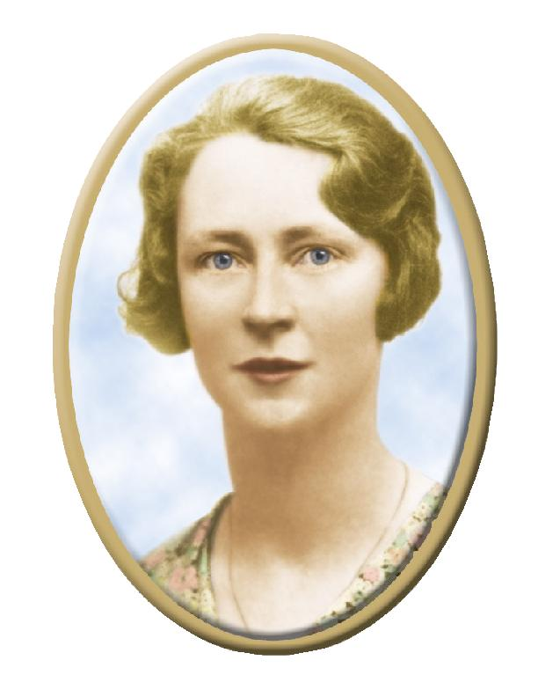
Venerable Edel Quinn
September 14, 1907 – May 12, 1944

Slide 2
Some Legion Terms
Frank Duff – founder of the Legion
Concilium – highest council (in Dublin)
Senatus – regional council
Comitium – council that usually covers several counties
Curia/curiae – council that usually covers a county
Praesidium/praesidiae – local unit(s) of the Legion
Acies – annual consecration ceremony
Envoy – legionary who devotes several years to extend the Legion in another country
Maria Legionis – the Legion of Mary magazine

Slide 3
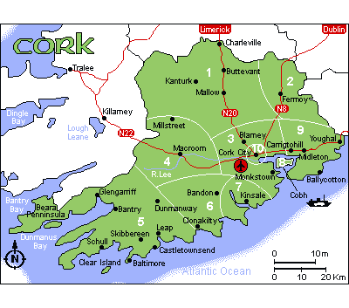
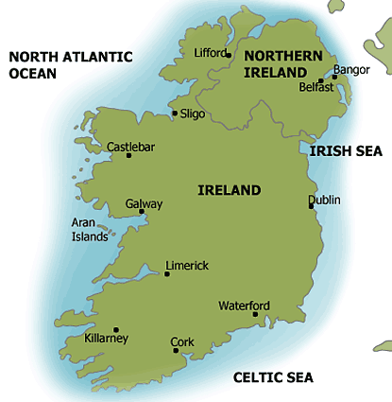
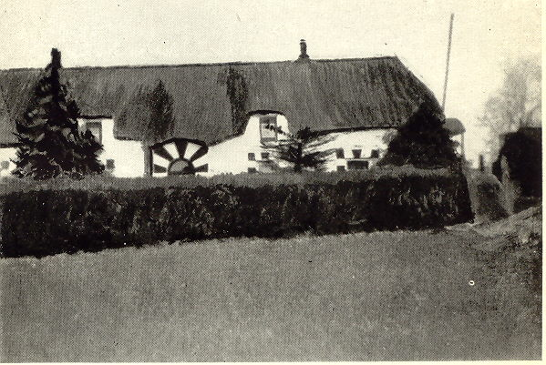
Edel Mary Quinn was born on
September 14, 1907 in Kanturk, County Cork, Ireland
Notes:
(SLIDE) Kanturk is in the south of Ireland. This photo is of her birthplace.

Slide 4
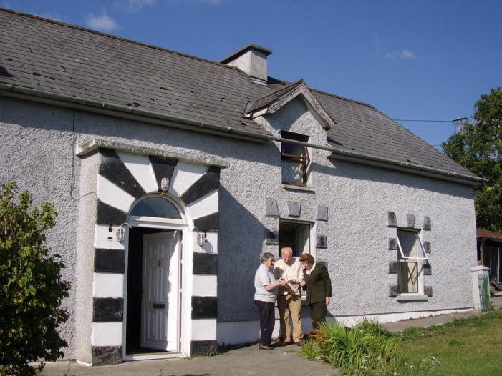
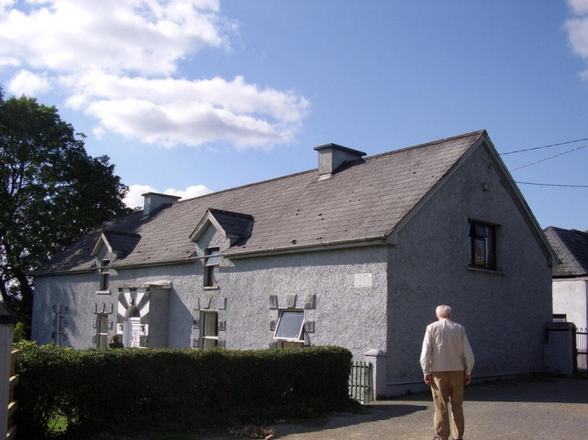
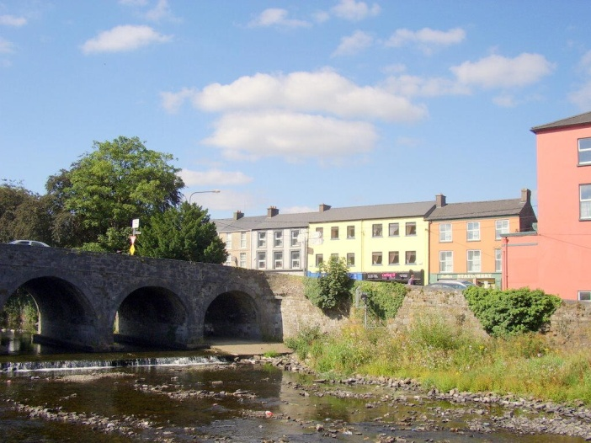
Kanturk (then and now)

Slide 5
Family Background
William
Quinn
Elizabeth
Egan
Edmund
Browne
Elizabeth
O’Reilly
Charles Quinn
Co. Galway
1871
Louise
Burke Browne
Co. Clare
1871
Edel Mary
Quinn
1907
Notes:
Edel’s father, Charles was born on November 12, 1871 in Tuam, Co. Galway and worked as a banker. Her mother was born earlier the same year in Kilmihil, Co. Clare and was the youngest of seven daughters of a well-to-do farmer.

Slide 6
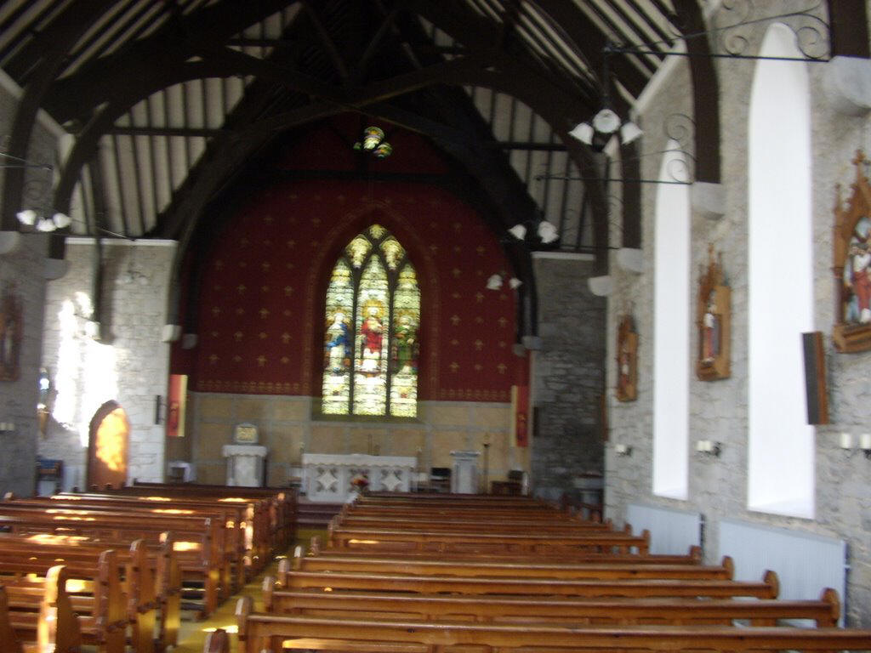
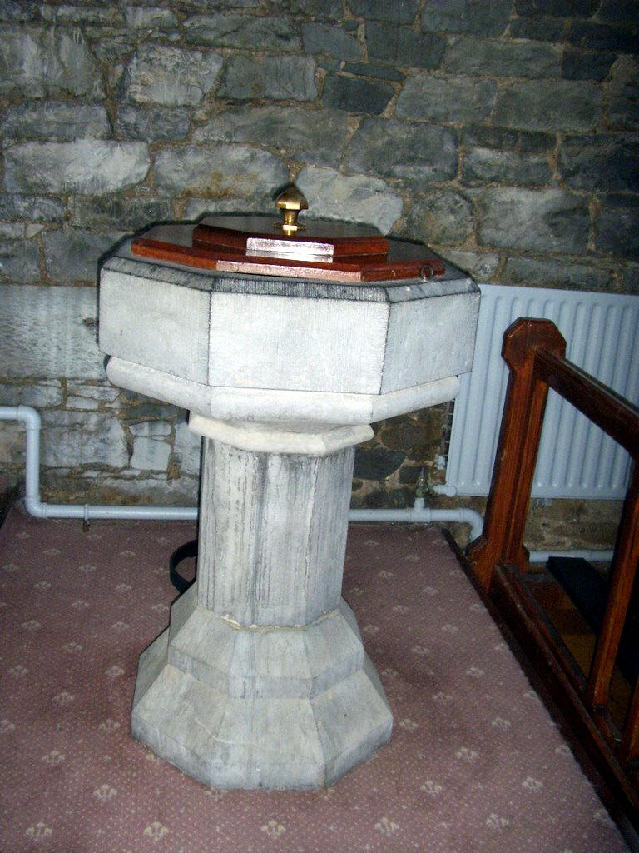
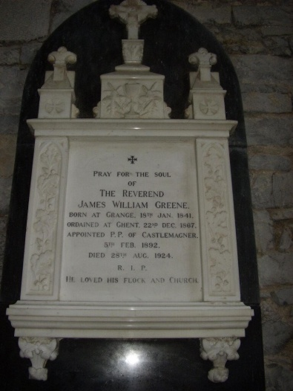
Edel was baptized on
Sept. 18, 1907 in Castlemagner
Notes:
These are recent photos of the church and baptismal font and the tomb of the priest who baptized Edel: Fr. James Greene.

Slide 7
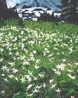

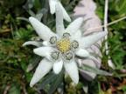
“Edel”, not “Adele”
The Edelweiss is a delicate looking flower that survives gallantly in the cold Alpine mountains. It comes from the German words “edel”, meaning “noble”, and “weiss”, meaning “white”: an appropriate name for one whose nobility of spirit and joyous radiance became proverbial.
Notes:
It was thanks to Fr. Greene that Edel received her name. Since the baptism took place only four days after the birth, Mrs. Quinn was not present. She had intended to call her first daughter “Adele” after one of her sisters. The priest mistook the name as being from the flower Edelweiss. It turned out to be very appropriate as we will see. (SLIDE)

Slide 8
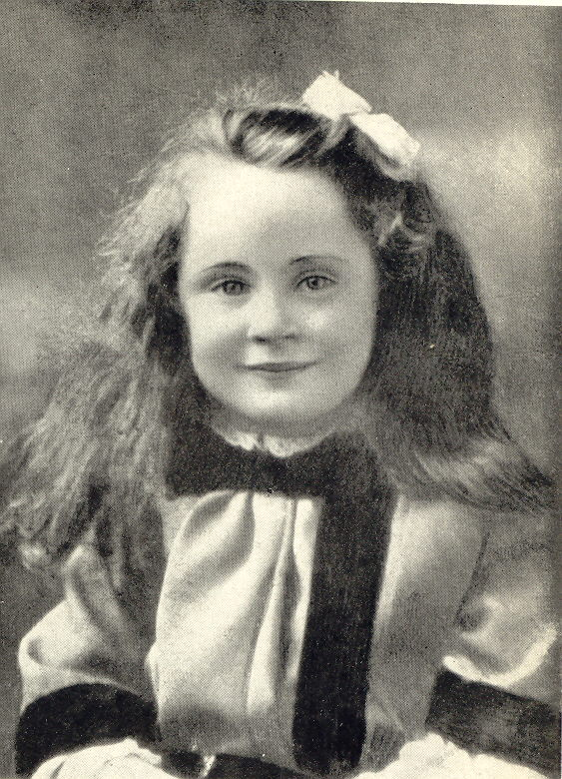
Siblings
Edel, born 1907
Leslie, born 1909
Ralph, born 1911
Mona, born 1914
Dorothy (known as “John”), born 1915
Notes:
Edel at age 4. (SLIDE, 5 clicks)

Slide 9
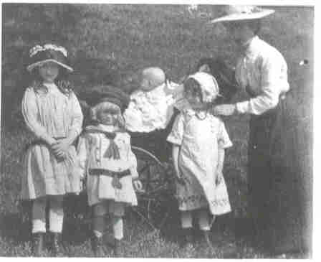
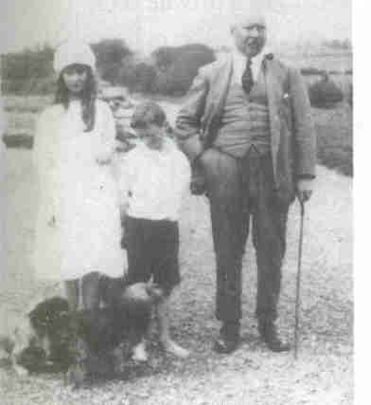
Family
Notes:
Mrs. Quinn with Edel, Leslie, Ralph, and Mona in 1914.
Mr. Quinn with Edel and Ralph in 1920.

Slide 10
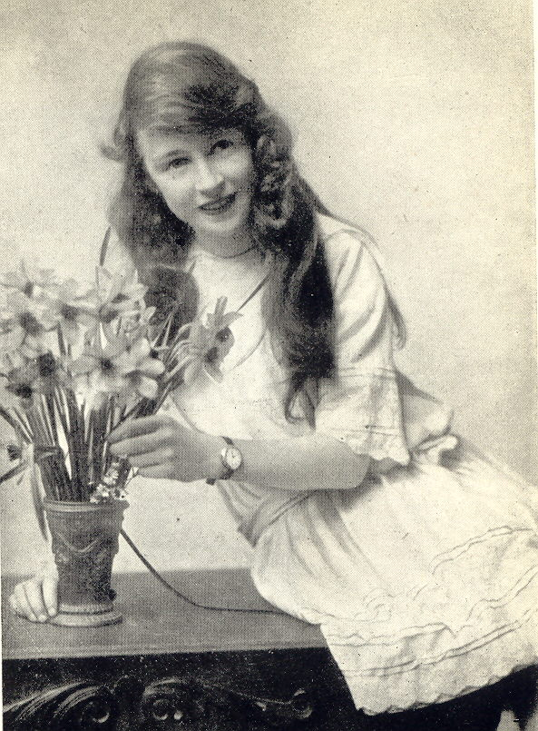
Many Moves
Clonmel (near Tipperary) 1907-1913
Cahir 1913-1917
Enniscorthy, Co. Wexford 1917-1921
Tralee 1921-1924
Monkstown (a suburb of Dublin)
Notes:
This photo shows Edel at the age of 11.
Mr. Quinn was a banker who was promoted several times throughout the years, causing the family to be relocated. However, he had a weakness for gambling, and in 1924 was caught using bank money to cover his debts. The bank chose not to prosecute, but he lost his position as manager and took a job as “ledger clerk” in Monkstown. (SLIDE 5 clicks)

Slide 11
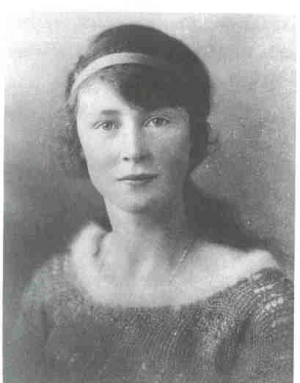
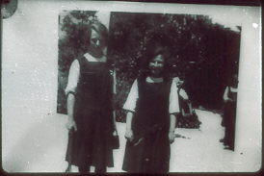
School Years
Edel Mary Josephine Eucharia Quinn
Notes:
Prior to her father’s demotion, Edel attended private schools.
In Cahir, she attended a school run by the Sisters of Mercy and was prepared there for her first Confession and First Holy Communion which she made on Ascension Thursday, June 1, 1916.
In Enniscorthy, she attended school at the Loreto Convent and it was here that she was Confirmed on October 27, 1918, taking the names Josephine Eucharia in honor of St. Jospeh and her devotion to the Holy Eucharist.
In 1923, at the age of 16, she was sent to finishing school at Upton Hall near Liverpool. She would leave Upton the next year due to her father’s troubles.

Slide 12
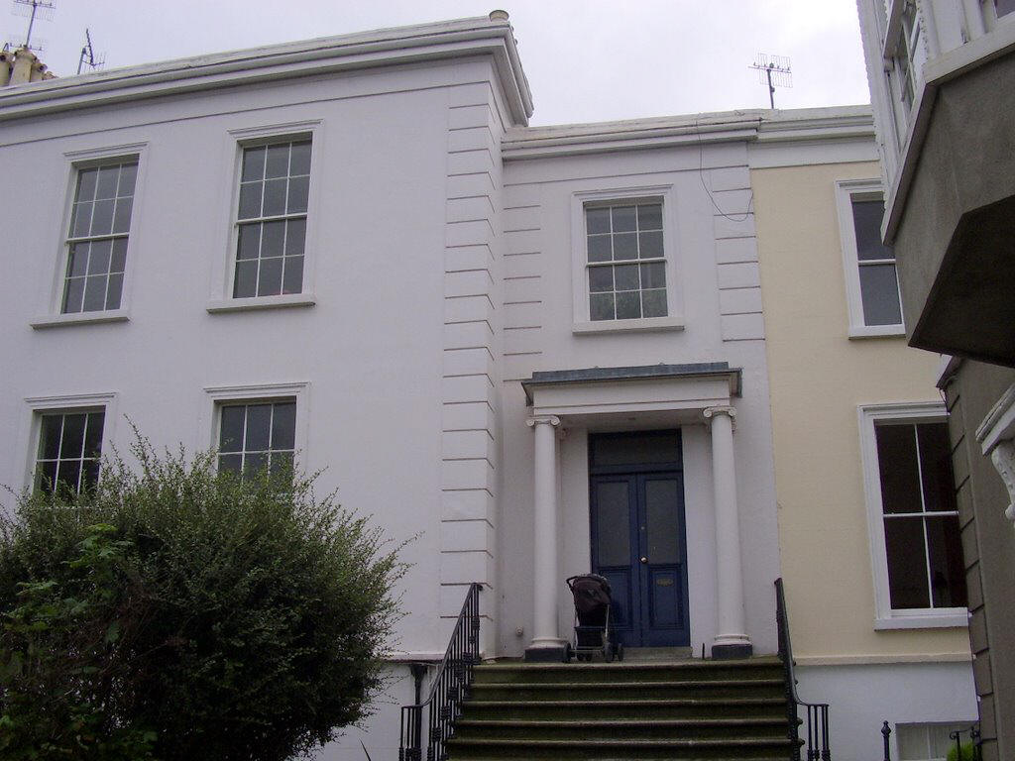
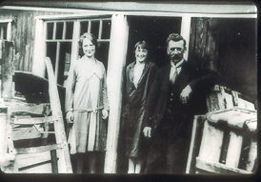
Return to Monkstown
Chegney Tile Works
Notes:
A recent picture of the Quinn’s home in Monkstown.
Edel returned home to help the family. She took a secretarial course and secured a job at Chegney Tile Works. In this photo she is shown at work with her sister, Leslie, and Mr. Fagan.

Slide 13
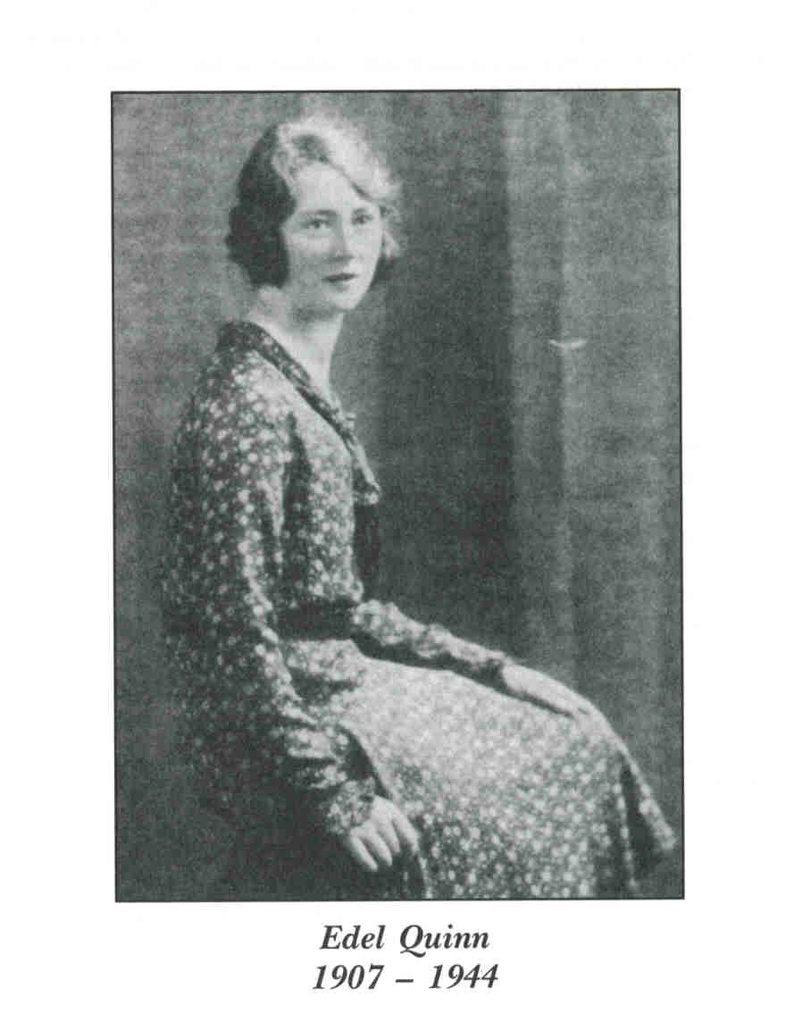
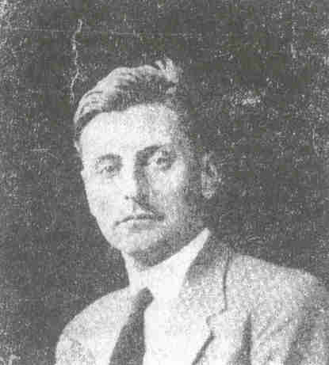
A Proposal`
Pierre Landrin
Notes:
In the course of her work she met Pierre Landrin. They developed a close friendship and, on Sept. 1, 1927, Pierre asked Edel to marry him. She revealed to him then that it was her dream to be a Poor Clare nun. Pierre and Edel continued a regular correspondence after this. Pierre later married and named one of his daughters Edel. He died in France in 1980.

Slide 14
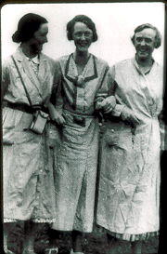
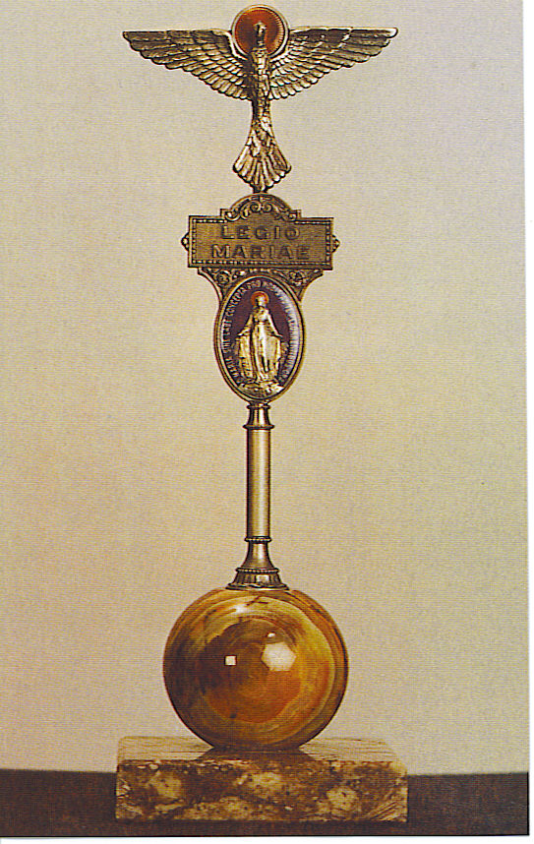
The Legion of Mary
Notes:
Edel’s first introduction to the Legion came in 1929 when she ran into an old family friend, Mona Tierney. She invited Mona home to see the family, but Mona declined because it was the night of her Legion meeting. Edel asked her about it and went along as a guest. Mona told her president at the time that she was not sure the Legion would appeal to Edel.

Slide 15
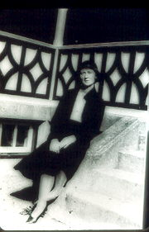
Praesidia & Works
Our Lady of Victories: visits to the poor
Our Lady, Refuge of Sinners: rescue of street girls
Notes:
(SLIDE – 1st praesidium) When Frank Duff met Edel, he was very impressed. There was a need for a new president in the praesidium “Our Lady, Refuge of Sinners” which worked with street girls. He recommended Edel. Initially, the praesidium members were shocked at the appointment, but soon learned that the choice was a good one.

Slide 16
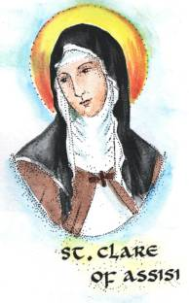
The Poor Clares
In January of 1932, Edel made plans to enter the Poor Clares. She was to leave for Belfast on the Feast of the Annunciation, March 25th.
Notes:
SLIDE

Slide 17

A Change of Plans
Edel became ill and was diagnosed with tuberculosis
She entered Newcastle Sanatorium on February 5, 1932
She remained there until December
Notes:
SLIDE -3 clicks

Slide 18
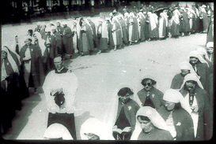
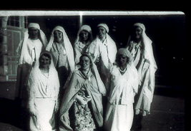
A Pilgrimage
Notes:
When she realized that staying at the sanatorium was not making much change in her condition, Edel returned to her family, took a job, and joined “Regina Coeli” praesidium which worked at a Children’s Hospital. In August of 1934, she joined a Legion Pilgrimage to Lourdes.

Slide 19
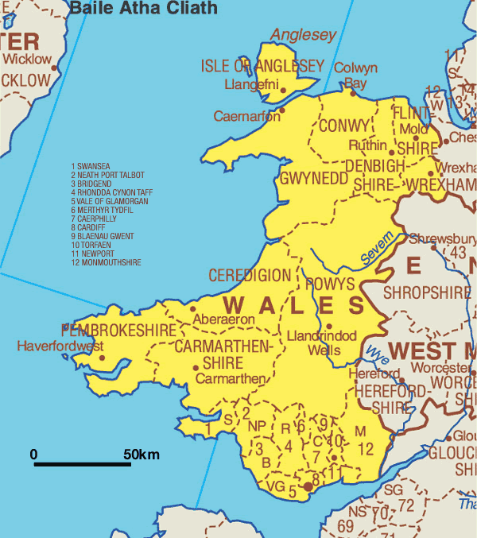
Extension
In the summer of 1936, Edel volunteered for a two-week’s extension assignment in Wales.
After returning to Dublin, she asked permission of the Concilium to return there to work for the Legion full-time.
Notes:
SLIDE

Slide 20
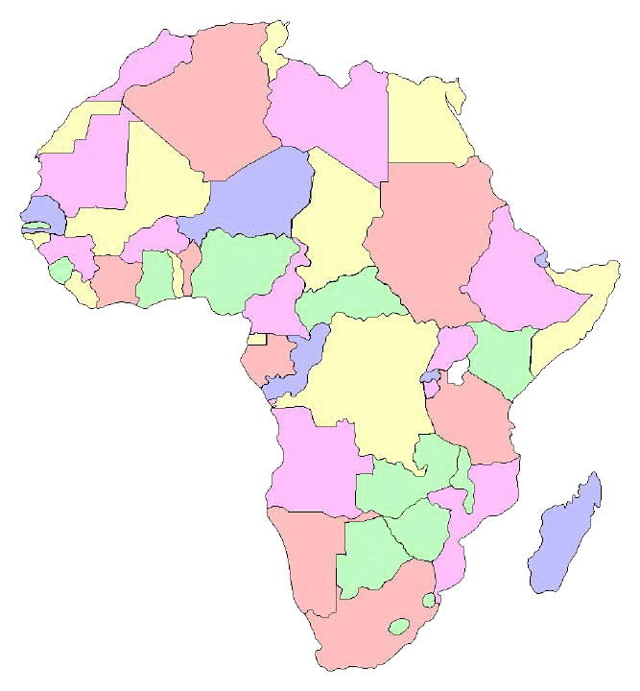
A Request
Meanwhile, the Concilium received a request from Bishop Heffernan for someone to organize the Legion of Mary in East Africa.
When Edel was asked if she would accept the assignment in Africa instead of England, she replied, “with all my heart.”
Notes:
SLIDE

Slide 21
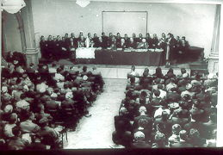
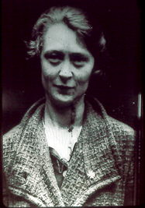
Approval
Edel’s appointment as envoy to East Africa was unanimously approved by the Concilium in September of 1936.
Notes:
(SLIDE) This approval happened only after much discussion, however. A Legion spiritual director, Fr. Magennis, initially gave strong reasons for not sending a girl in a delicate state of health to a place with such harsh conditions. Edel stood up and stated that she was going into this with her eyes open – that she knew she wasn’t going on “a picnic”. Fr. Magennis responded that she’d make a fine picnic for some wild animal. Frank Duff called on everyone to see that the “picnic” would not be a substantial one! This lightened the atmosphere and when the vote was called, all approved the appointment.

Slide 22

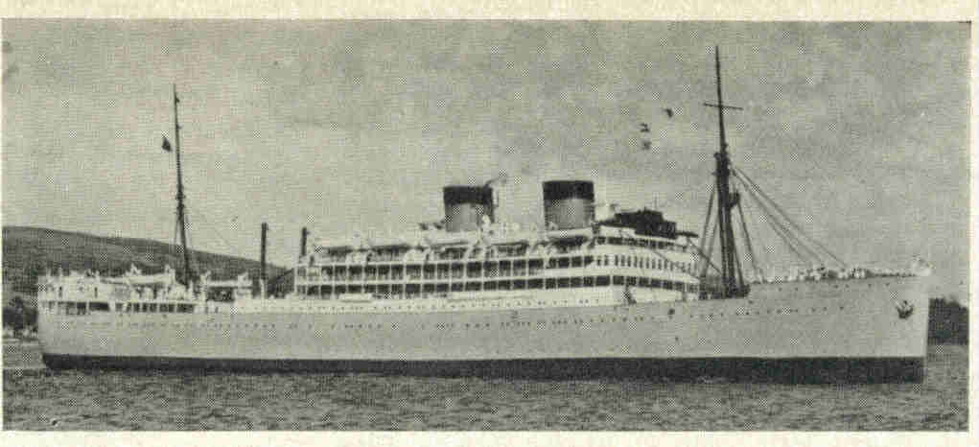
Departure
The Llangibby Castle
Notes:
Bishop Heffernan, the Vicar Apostolic of Zanzibar, suggested that Edel travel with his missionaries on the Llangibby Castle which would leave on October 29, 1936. She traveled with a group of Loreto Nuns and was able to make contact with Holy Ghost Fathers, Mill Hill Fathers, and White Fathers in the course of her trip.

Slide 23
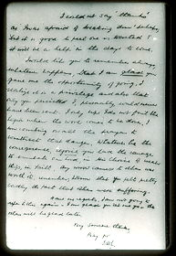
Her First Letter
Edel’s first correspondence to Dublin was a letter addressed to Frank Duff. She thanked him for having given her the opportunity of going, in spite of the fact that it caused sorrow to others. “Have no regrets,” she wrote, “the others will be glad later.”
Notes:
SLIDE

Slide 24
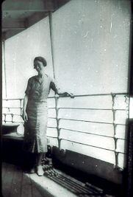
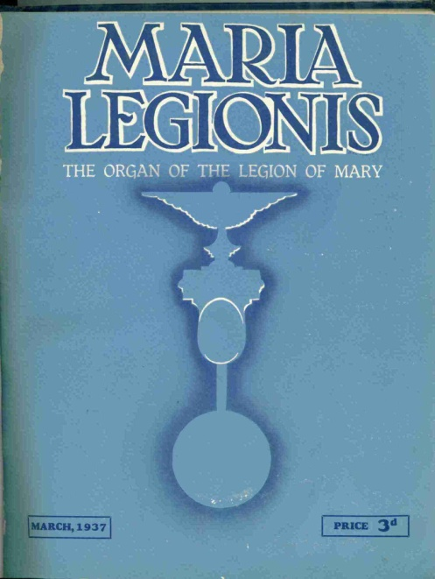
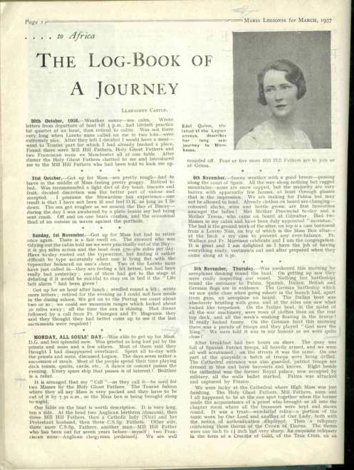
The Voyage
Notes:
Edel spent the month-long voyage contacting other passengers and priests and sisters at the ports of call about the Legion. She kept a log-book which was published in the very first issue of Maria Legionis: March, 1937.

Slide 25
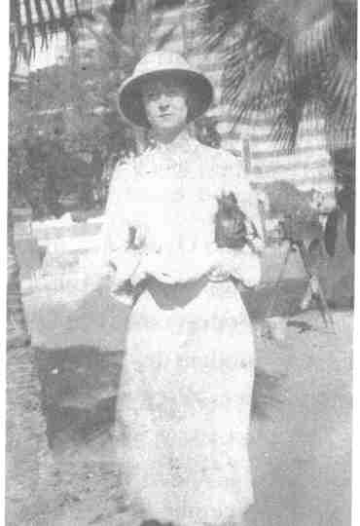
Along the Way
10/29/36: Departure from London
11/12/36: Port Said, Egypt – Edel’s first time on African soil
11/15/36: Port Sudan
11/23/36: Arrival in Mombasa
Notes:
(SLIDE) The photo shows Edel at Port Said.
At Port Sudan, Edel visited a convent of Italian nuns and told them and the priest about the Legion. When she discovered that there would be only a handful at Benediction, she raced back to the ship and gathered a crowd to attend. It was her first Benediction on African soil. She promised to have Dublin send Italian handbooks.

Slide 26
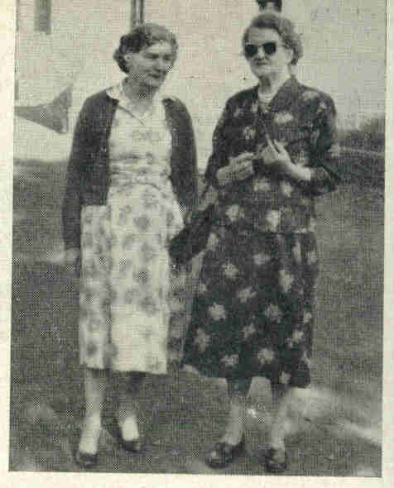
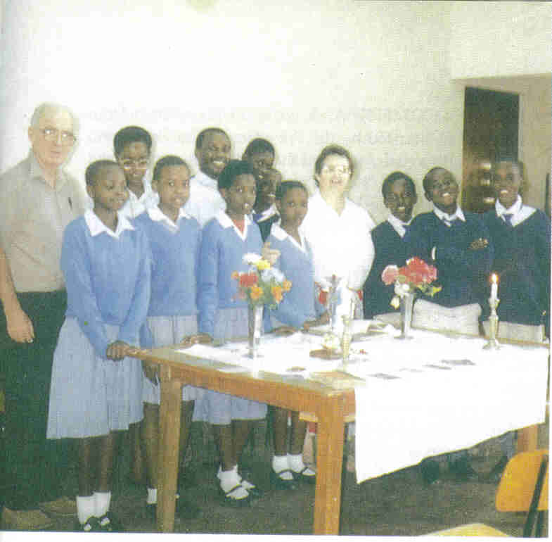
First Praesidium
Edel arrived by train in Nairobi on November 28, 1936
On December 8th, she held the first information meeting of the Legion
The first praesidium was named “Our Lady of the Immaculate Conception”
Notes:
(SLIDE) The parish priest, Fr. O’Flynn, was not receptive to the Legion. He did his best at the first meeting to sabotage the start of the Legion in the parish, but several parishioners pointed out important works in the parish that the Legion could be doing. Father gave his reluctant o.k., but limited the membership to non-native women. The original group was made up of four Irish women and two Goans.
(SLIDE -2 clicks) The first photo shows Sr. Gannon and Sr. Cronk, two legionaries recruited by Edel. Sr. Gannon became the president of the first praesidium.
The second photo shows the junior praesidium belonging to this first praesidium almost 60 years later, in 1994.

Slide 27
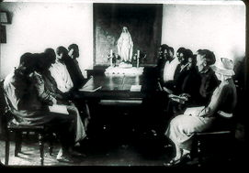
Reception by the “Natives”
Notes:
The Africans were known as “natives” and the Europeans and Goans (Asians) as “non-natives”. Edel’s hope was to have mixed praesidia, but found that it was necessary to start with separate ones due to the discrimination that was present in Kenyan society at the time. Edel found the Africans to be extremely receptive to the Legion and on December 13th, the first native praesidium was formed with 16 men and 11 women.

Slide 28
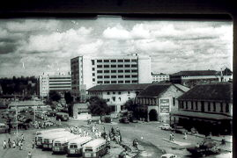
Challenges
Racial Tension
  Europeans
  Goans
  Africans
Language
  English
  Swahili
  Kikuyu
Notes:
Edel had many challenges in the Nairobi of 1936. SLIDE – 4 clicks

Slide 29
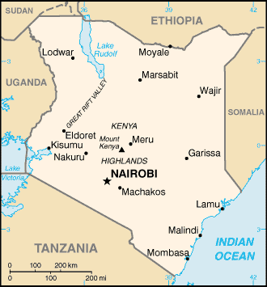
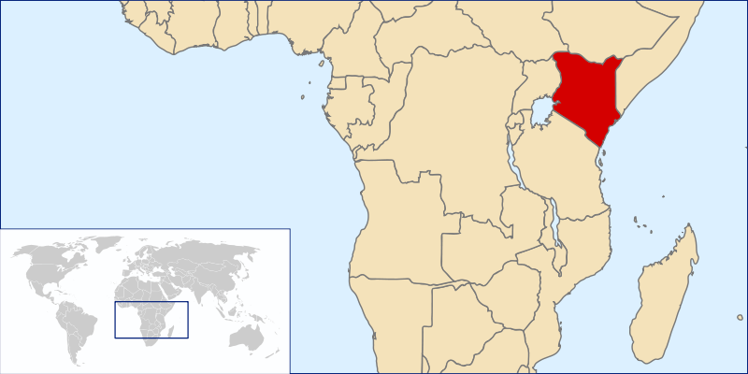
Edel’s Mission Territory:
Kenya . . .

Slide 30
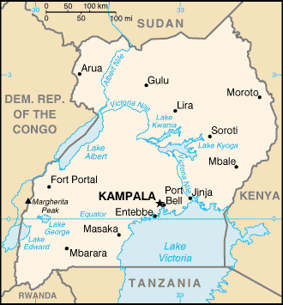
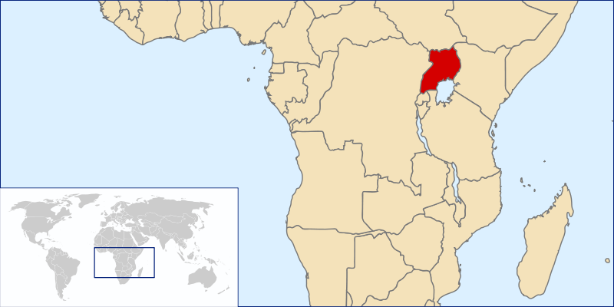
. . . Uganda . . .

Slide 31
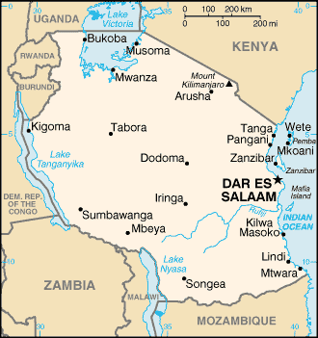
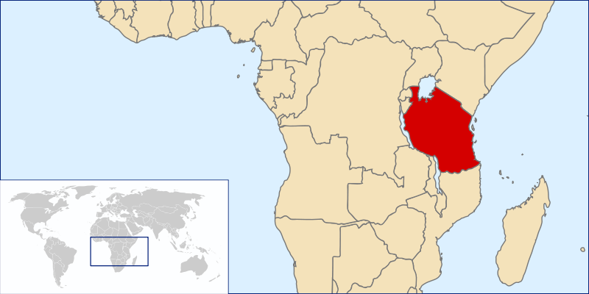
. . . Tanzania . . .

Slide 32
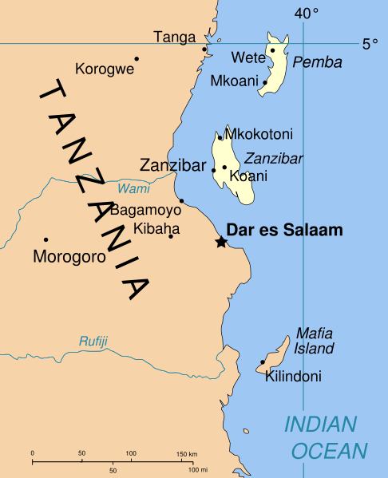
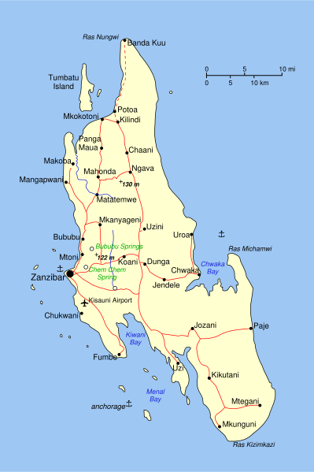
. . . Zanzibar . . .

Slide 33


. . . Nyasaland (now Malawi) . . .

Slide 34


. . . Mauritius
Notes:
The total area Edel would cover was about twenty times the size of Ireland.

Slide 35

Early Results
Edel succeeded in having a “mixed” Acies at St. Peter Claver Church in Nairobi on April 4, 1937.
The ceremony was held using English, Swahili, and Kikuyu
Notes:
By early April, 1937 Edel had established 10 native praesidia with a total of 155 active members and 4 non-native praesidia with a total of 44 members. The six praesidia within walking distance of St. Peter Claver Church participated in the first Acies. (Some of the members walked twelve miles each way to attend.) Seven priest spiritual directors attended and are seen in the photo with Edel in the center. This photo appeared in the June, 1937 issue (the second issue ever) of Maria Legionis.

Slide 36

The Priests
Edel received support and help from many of the priests she met.
A particular friend was Fr. John Reidy who was from County Clare and knew many of Edel’s relatives on her mother’s side.
Notes:
Many of the priests Edel worked with acted as translators for her at the meetings and assisted with transportation. (SLIDE)

Slide 37

First Bout with Illness
On May 29, 1937 Edel moved on to Mombasa and began her work there
She became ill on June 13th with malaria
Hesitance to inform Concilium
Convalescence in Limuru
Notes:
(SLIDE) Edel was afraid that she was still “on probation” as an envoy and was therefore hesitant to let the Concilium know of her illness. Fr. Reidy took her to a convent in Limuru and obtained medical attention for her. After her convalescence, he organized a picnic in the Riff Valley for her and some of the sisters, which is where this photo was taken. She sent the photo home and her family was pleased with how well she looked. Her mother wrote, “The next thing we hear is that you’ll be getting married in Africa!”

Slide 38

Archbishop Riberi
Apostolic Delegate to Africa
In a letter of introduction for Edel to his 33 Bishops, dated 6/25/37, Archbishop Riberi writes of the Legion:
“I like to think that it is the nearest approach to the ideal of Catholic Action as fostered by the Holy Father. . . .Hence, my recommendation is an earnest one.”
Notes:
(SLIDE) This letter gave Edel an added incentive to begin traveling further afield.

Slide 39
1937/1938 Highlights
A Curia is established in Nairobi
The handbook is being translated into Kiswahili and Kikuyu
A Curia is established in Zanzibar
The tessera is translated into five languages: Swahili, Kikuyu, Luo, Bantu, and Kesii
Notes:
(SLIDE – 4 clicks) The June 1938 issue of Maria Legionis notes that “The amazing extent, variety, and success of her labours may be gauged from the fact that so far it has been necessary to translate the Tessera into five native languages to provide for the Praesidia which she has started.”

Slide 40

Transportation Troubles
On May 9, 1938 Edel purchased a 1932 Ford for 65 pounds and named it “Rolls Royce”
Notes:
Transportation was very difficult in the areas where Edel traveled. Occasionally she could get a ride from a priest. More often, she would hire a car but could never count on it showing up on time or even at all. Early in 1938 she wrote to Dublin asking permission to buy a car. (SLIDE) On May 25, 1938 she did get her driver’s license, but her traveling was done with hired drivers. She had a series of those, some of whom were dismissed for drinking or for “borrowing” money at the convents she visited.

Slide 41
Uganda
7/22/38: Edel arrived in Uganda
Initially, it was the most difficult of all her mission fields
At the end of September, a new Vicar arrived and he was strongly in favor of the Legion
By mid-October most of the missions in the Upper Nile area had the Legion
Notes:
(SLIDE – 2 clicks) Mother Kevin, the foundress of the Franciscan Missionary Sisters for Africa and the Little Sisters of St. Francis had been working in Uganda for 35 years when Edel arrived. She did not give her endorsement of the Legion and so, Edel was denied access to some of the vicariates. (SLIDE – 2 more clicks)

Slide 42




CHURCH
TWO PRAESIDIA
PRIEST’S HOUSE
Notes:
Edel found very primitive conditions in some of the missions she worked with. While the priest was away, Edel spent three nights in this priest’s house, which has no windows or doors. At another mission, she heard “snorting” outside her window and, looking out, found that it was a hippo! A highlight of her work in Uganda was the establishment of a lepers’ praesidium.
The Church shown here was where Edel attended the Requiem Mass for Pope Pius XI when he died in 1939.

Slide 43
One Example of Results
Dublin received numerous letters and reports from people touched by Edel.
For example, one Spiritual Director wrote:
“Within a period of three months my Legionaries helped to bring in for instruction 100 male and 40 female adult Catechumens.”
Notes:
SLIDE

Slide 44
Second Bout with Illness
Edel intended to sail to Mauritius on December 31, 1938
12/7/38: a second attack of malaria
She was forced to recuperate until after Christmas
She continued her work in Upper Nile until the end of February
Notes:
SLIDE

Slide 45
Report in June 1939 Maria Legionis
Upper Nile vicariate work completed: 23 senior and 9 junior praesidia established
Return to Kisumu vicariate: five new praesidia were formed since her last visit
Vocations from junior praesidia: 9 entered the convent and 2 entered the seminary
250 attended the Acies in Nairobi
Notes:
SLIDE – 4 clicks

Slide 46

1939 Acies in Nairobi

Slide 47
Some 1939 Highlights
One spiritual director reported:
A praesidium with 20 active members
93% attendance although the president had to walk 10 miles and others 6 miles to get to the meeting
112 returns to the Sacraments
13 infants baptized
14 marriages validated
23 pagans under instruction
7 junior members entered the seminary
Notes:
SLIDE – 7 clicks

Slide 48

War
9/1/39: Hitler invaded Poland
Edel’s travel was limited
Correspondence was delayed
Gas was scarce
Edel got official recognition as a missionary which gave her the right to a gas ration for her work
Notes:
SLIDE

Slide 49

1940
Mauritius postponed until French edition of the handbook is available
4 months in Bagamoyo and Dar-es-Salaam
Started 8 praesidia in Bagamoyo
Started 11 praesidia in Dar-es-Salaam
Notes:
SLIDE – 4 clicks

Slide 50

Mauritius
Archbishop Leen asked Edel to come to his diocese.
She spent the summer there and left him with 30 praesidia and a curia.
Notes:
(SLIDE) Archbishop Leen is shown here with the governor of Mauritius. Notice the Legion Standard coming out of the governor’s hat!

Slide 51



Notes:
The first photo shows the first Curia meeting held on May 19, 1940 in Port Louis. The curia consisted of the Archbishop, 20 spiritual directors, 293 active, and 60 auxiliary members.
The second photo shows the dedication of a new shrine in honor of Mary, Queen of Peace. 350 legionaries participated in the procession with the Legion Standard.
The third photo shows the Cathedral in Mauritius where Mass a farewell Mass was said for Edel on August 28, 1940.

Slide 52
Archbishop Leen wrote to Dublin:
“Your thanking me for having welcomed your envoy seems to me like offering somebody Ł1,000 and thanking him for accepting the present. All the gratitude should be on our side. I am ever so happy to see the Legion started here. Miss Quinn has succeeded in putting it on a solid foundation. She has the gift of quiet and effective organization. Miss Quinn is about to leave for Africa; her courage is unabated.”
Notes:
SLIDE

Slide 53
Nyasaland
Edel initially started 7 praesidia including a seminary praesidium
The tessera is translated into Chinanja
Soon a curia was formed with 8 senior and 2 junior praesidia
Later, two curia and a leper praesidium
Notes:
SLIDE – 4 clicks

Slide 54
Death?
A rumor of Edel’s death spread through the area
Masses were said for the repose of her soul
Dublin received letters of condolence
Edel wrote: “Several priests wrote me since, congratulating me on the Resurrection.”
Notes:
(SLIDE) Edel never did find out how the rumor started.

Slide 55

Third Bout with Illness
In January 1941, Edel came down with dysentery and malaria.
Although she was very weak, she traveled to Shiré to establish a curia.
Her weight dropped to 75 pounds.
Notes:
(SLIDE) Edel hoped to relieve her family’s anxiety about her health by sending them a photo – it did the opposite!
Bishop Julien invited her to a convent in Likuni to recuperate.

Slide 56

Ruby Roberts
Dublin sent a telegram to Ruby Roberts, envoy to South Africa
Ruby took Edel to Johannesburg
Edel was admitted to a government-run sanatorium named Springkell for tuberculosis treatment
Notes:
SLIDE

Slide 57


Umlamli
Notes:
Edel’s biggest cross while in the sanatorium was that she could not get to Mass and Holy Communion.
Ruby Roberts was eventually able to get her transferred to a Catholic hospital in Cape Province. She entered Umlamli on November 14, 1941 and was able to receive Holy Communion every day. The second photo shows her at Umlamli with her “budgies.” By February 1942, Edel had brought her weight up to 90 pounds and with her doctor’s reluctant approval, decided to return to Nairobi.

Slide 58

Blessed Louis Marie de Montfort
On page 1 of the March 1942 issue of Maria Legionis, we read: “This moment, when the Canonization of Blessed Grignion de Montfort has reached final stages, is opportune for asking that every Legionary will make a Novena to him for the vital intention that Edel Quinn, our Envoy to Central Africa, be given sufficient health to enable her to resume her mission....We are sure that if Legionaries unite at this notable juncture to ask the Blessed Grignion de Montfort for this favour so near to their hearts, and so necessary for the Legion and for Africa, he will secure it for them.”
Notes:
In the meantime, Concilium asked the Legion for help. (SLIDE)

Slide 59
Result
Maria Legionis, December 1942:
“STOP PRESS
A little while ago we heard that Edel Quinn had uprisen from bed and was setting off for her former envoy district in Central Africa....We are led to wonder if we are not looking on at that response to prayer for which we have been hoping.”
Notes:
SLIDE

Slide 60
Back in Nairobi
A missionary priest wrote to Dublin:
“Miss Edel Quinn, the Legion Envoy to Central Africa, is back with us again. Last we heard of her she was near death’s door down South, and then she comes by plane, as lively and full of beans as ever. Extension work has gone off with a bang since her arrival. All are glad to have her here again. . .”
Notes:
On January 11, 1943 Edel flew to Nairobi as other means of transportation had been interfered with due to the war. (SLIDE)

Slide 61


The Acies in Nairobi was attended by 15 spiritual directors and 350 active legionaries
Bishop Heffernan presided
Sermons were preached in Kiswahili and English
Notes:
SLIDE

Slide 62

A new army praesidium was formed.
(This was the last photo sent by Edel Quinn to Concilium.)
Notes:
SLIDE

Slide 63

Fourth Bout with Illness
Edel came down with malaria again in February
Bishop Heffernan arranged for Edel to be able to live inside the enclosure of the Carmelite community
Notes:
(SLIDE) This had to be done in secrecy because it was very unusual to allow a lay person this privilege. Edel spent Lent and Easter with the Carmelites.

Slide 64


Continued Work
Letters
Visits to curiae and praesidia
Comitium in Nairobi
Curiae in Kilimanjaro
Curia and Comitium in Nyeri
First one-day retreat for male legionaries
Notes:
SLIDE – 6 clicks

Slide 65

Final Bout with Illness
Edel formed a Curia in Kisumu
She was too weak to establish the one in Kakamega
She asked Sr. Dickson, president of the Nairobi Comitium to take her place there
Notes:
(SLIDE) The train ride from Nairobi to Kisumu was 18 hours long. Edel made this trip in March and in April of 1944. (SLIDE)

Slide 66


“Death of a Heroine”
In April 1944 Edel returned to Nairobi more dead than alive, hardly able to walk.
She was confined to the summer house in the garden.
It was here that she was found unconscious on the evening of May 12, 1944.
Notes:
SLIDE – 3 clicks

Slide 67
Maria Legionis: July, 1944
“She received the last Sacraments there in the garden – now conscious of everything. She was taken in to the Convent. She sank to rest in the pillows of her bed. She called on the Holy Name of Jesus three times, and then that of Mary three times also. O the valiant missionaries that have cried out those words from the depths of African forests and marshes! . . .
Notes:
SLIDE

Slide 68
. . . They must have answered her call as the soldiers of many an earthly army have gathered to their dying comrade. The dying legionary then turned on her side – it is the posture that for some strange reason the countless thousands of early martyred virgins made before death. She called once again the name of the Lover of us all and then her spirit went forth to meet Him.”
Notes:
SLIDE

Slide 69


Notes:
The last thing Edel touched was this crucifix. Fr. McGregor, Comitium spiritual director, is holding the cross at a talk he gave in Philadelphia in 2004.

Slide 70

A Dream Realized
Edel was laid out in the habit of the Sisters of the Precious Blood.
Thus her dream of a religious vocation was symbolically realized in death.
Notes:
SLIDE – 2 clicks

Slide 71

Notes:
The house where she died was later given to the Legion of Mary.

Slide 72
Maria Legionis: July, 1944
“Miss Quinn’s death was a landmark in the conquest of Africa to Christianity. Her funeral, which was a triumph, gave proof of this. An immense concourse of people – many of them her own children – legionaries – assisted at it with twenty priests and the Bishop of the Vicariate, Dr. Heffernan . . .
Notes:
SLIDE

Slide 73
. . . She was laid to rest in the mission cemetery – ordinarily reserved to priests and religious. . . . The gift of the Legion to its beloved Africa – the original flesh of a first and lay apostle to be the seed of unending grace and glory in that great continent.”
Notes:
SLIDE

Slide 74

Notes:
The legionaries of Kenya, Uganda, and Tanganyika erected a large Celtic cross over her grave. At the base of the cross, there is an inscription which reads: “She fulfilled her mission with such devotedness and courage as to stir every heart and to leave the Legion of Mary and Africa itself forever in her debt.”

Slide 75

Notes:
The Holy Father himself paid tribute to her great services to the Church. The first page of the September 1944 issue of Maria Legionis notes that in spite of the fact that Rome was occupied by the Nazis at the time, Pope Pius XII sent a telegram “notifying the happy death of our African Envoy, Edel Quinn, and paying tribute to her great missionary labours”.

Slide 76

Her Legacy
Edel Quinn’s legacy was not only to the Church of Africa, it was to the Church in China as well. Four years after her death, a Columban priest by the name of Fr. Aedan McGrath was commisioned by Archbishop Riberi to accomplish in China what Edel Quinn had accomplished in East Africa.
Notes:
SLIDE

Slide 77




Well Known to Legionaries . . .
Notes:
Edel’s life story was made known to legionaries all over the world through feature articles in Maria Legionis. These covers are from 1963, 1977, and 1994. Frank Duff, in a talk on envoys, is pointing to Edel Quinn’s name on the map.

Slide 78


. . . and to the World
Notes:
The first major work on Edel Quinn was this book, written by Cardinal Suenens in 1952.

Slide 79



Notes:
This was followed by many other books on her life.

Slide 80

A Legion Saint
Edel’s Cause for Canonization was begun in 1963
She was declared Venerable on December 31st, 1994 by Pope John Paul II
Notes:
SLIDE – 2 clicks

Slide 81




Her Shrine
Notes:
A shrine was constructed in her hometown in Ireland.

Slide 82

Notes:
The president of Ireland, Mary Macaleese, visited her grave while in Nairobi.

Slide 83
Edel’s “Words of Life” continue to inspire legionaries
“Mary in me will love her Son.”
“I could assist at Mass the whole day long.”
“With Mary, I must be a channel of grace to every soul – or rather, Mary through me.”
“Our Mother’s most precious gift to her children is the Cross.”
“It is the will, the will, the will that matters.”
“For me the Legion comes before everything.”
Notes:
SLIDE – 6 clicks

Slide 84

1907-2007: A Blessed Century
Notes:
Edel has truly left her mark on the world in the past 100 years.

Slide 85
Venerable Edel Quinn
September 14, 1907 – May 12, 1944
Happy 100th Birthday!

