Slide 1

Alfie Lambe
Servant of God
June 24, 1932 – January 21, 1959
Notes:
Presentation in honor of Alfie Lambe's 75th birthday given by Edel Lukens on Sunday, June 17, 2007 at St. Agnes – St. John Nepomucene Church to the Philadelphia Senatus. Information and photos were taken primarily from Maria Legionis issues 1953-1959.

Slide 2
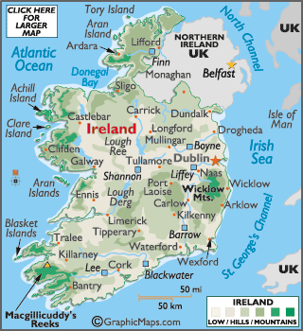


Alphonsus Lambe was born on June 24, 1932 in Tullamore, Ireland
Notes:
Tullamore is in the exact center of Ireland, to the west of Dublin.

Slide 3
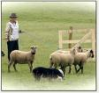
Country Boy
Alfie was the 8th child born to the wife of a farmer.

Slide 4
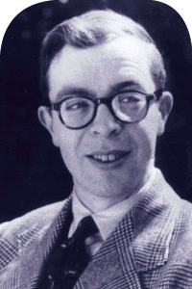

Teenage Years
On September 8, 1948, at the age of 16, Alfie was received into the Novitiate of the Irish Christian Brothers
He was given the name Br. Ignatius
It was here that he first heard of the Legion of Mary
Notes:
Alfie was present when Frank Duff gave a talk on the Legion to a group of Irish Christian Brothers.
Alfie later told him that it had made a great impression on him.

Slide 5

Beginning of Legion Membership
Due to ill health, Alfie returned home to Tullamore
He took a job in a mill
He joined the Legion there shortly after his 18th birthday
Notes:
He joined in July, 1950 just 12 days after his 18th birthday.
An experienced legionary from Dublin named Tom Cowley took him under his wing and trained him Legion work.
Around the same time, Seamus Grace a curia president in Dublin, went for several weeks to Donegal to extend the Legion during the summer holidays. This became an annual tradition for legionaries to spend their holidays extending the Legion.
Tom recommended Alfie to Seamus Grace to help with extension.

Slide 6
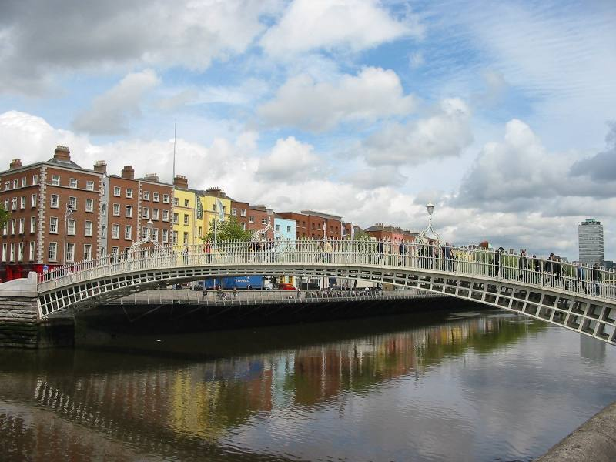
More Legion Experience
Alfie eventually moved to Dublin and became involved in the praesidium that ran Morning Star Hostel
He volunteered to do extension work throughout Ireland
Notes:
Alfie first orked with teams doing holiday extension, then volunteered to do a tour of extension in rural Ireland covering a period of about six months.
When he heard that Seamus Grace had offered himself as an envoy, Alfie was deeply affected and also volunteered himself as an envoy.

Slide 7
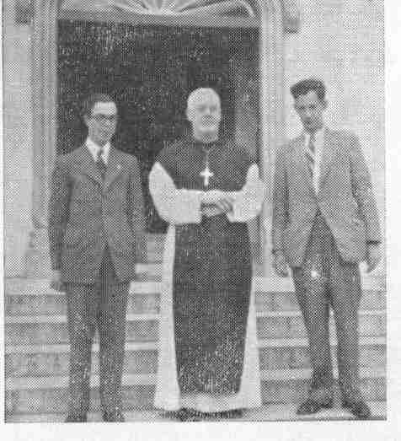
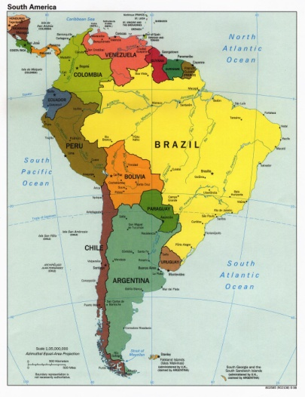
Legion Envoy
Alfie volunteered to go with Seamus Grace to South America to extend the Legion
The appointment was made by Concilium in 1953
Alfie was just 20 years old
Notes:
Frank Duff asked Seamus if he would like Alfie to go with him.
He gladly accepted and the appointment was made at the April 1953 Concilium meeting.

Slide 8

From Maria Legionis (June, 1953):
“The Concilium has appointed two further envoys for South America. Both are experienced members of the Concilium, and one, Mr. S. Grace, has been President of a Dublin Curia and a Vice-President of the Concilium. The other, Mr. Alphonsus Lambe, has recently completed a tour of extension and visitation in Ireland.”

Slide 9
“These two zealous and extremely competent Legionaries had most generously offered themselves to the Concilium for Envoyship. The need for extra Envoys in South America is urgent and of paramount importance. It is proposed that the two Envoys will proceed first to Colombia, where they would work as a team for some time.”

Slide 10
“They would visit the 12 Dioceses where the Legion is already established, and this would also give them valuable experience of local circumstances, problems, etc., in relation to their future work. They expect to leave for Colombia in July. Both Envoys appealed to Legionaries throughout the world for the constant support of their prayers.”

Slide 11
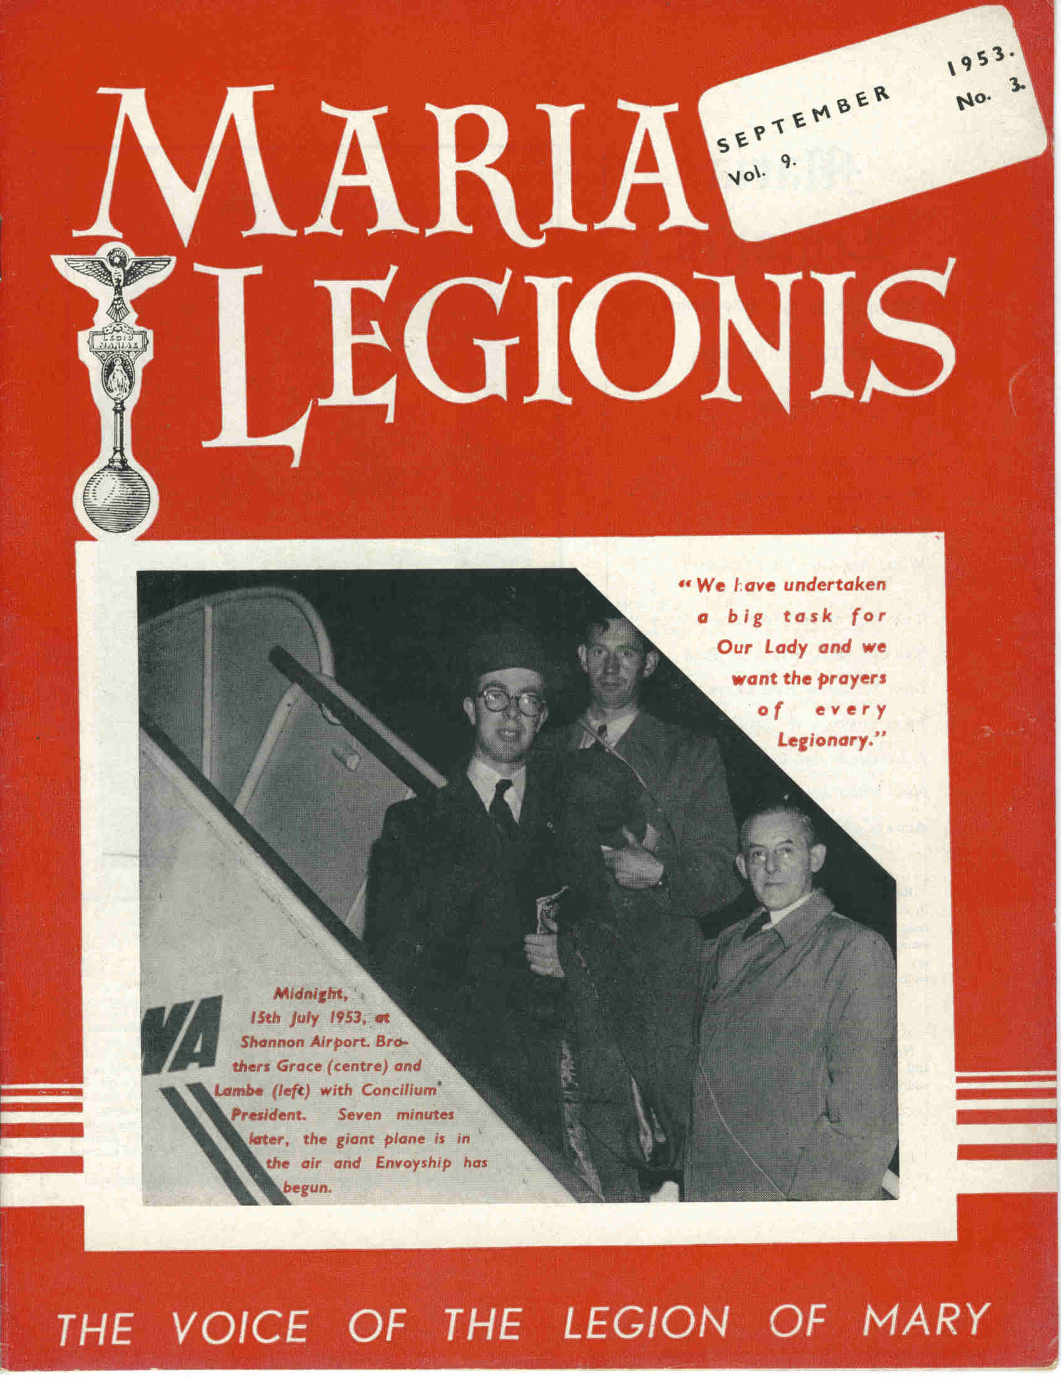
Seamus & Alfie departed Dublin on July 16, 1953, the feast of Our Lady of Mount Carmel
Notes:
Alfie and Seamus are seen on the cover of the Sept. 1953 issue with Frank Duff.

Slide 12
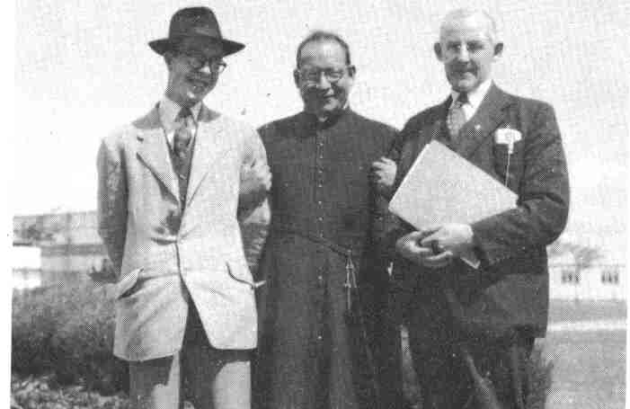
With Fr. Felix Mijica (from Venezuela) and Frank Duff at Dublin Airport
Notes:
During the months of preparation for the trip, the envoys studied Spanish and had the opportunity to practice it when the Concilium was visited by Fr. Mijica, founder of the Legion in Caracas, Venezuela and Fr. Jiminez, the founder of the Legion in Colombia.
Fr. Mijica was initially reluctant to have Alfie as an envoy because of his youth.
He said, “We in Venezuela have many tigers. If they see a lamb, they devour him immediately.”
This was the first of many puns about Alfie’s last name.

Slide 13
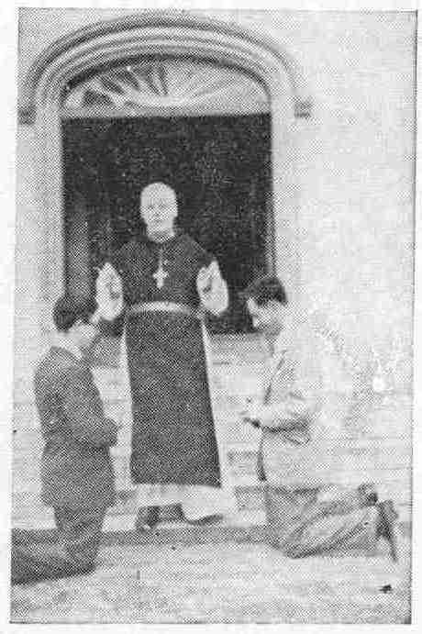
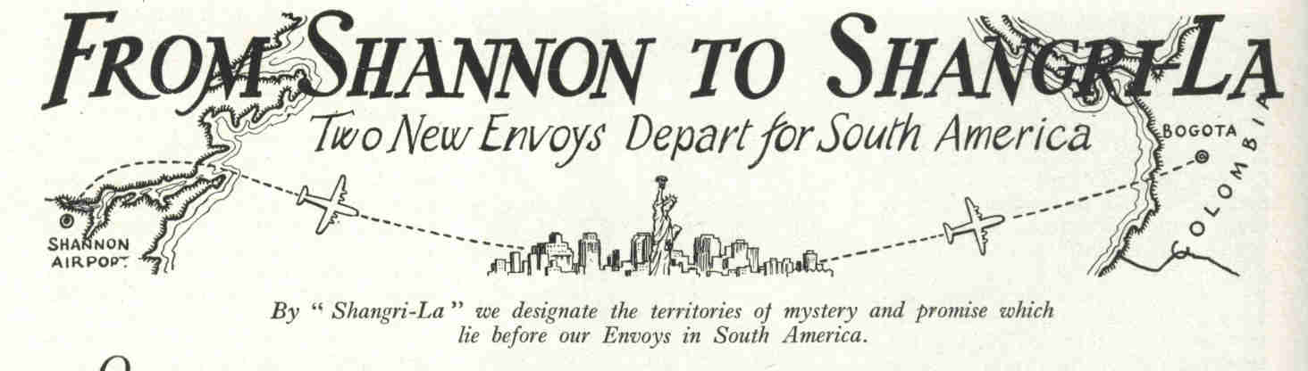
Departure
“By ‘Shangri-La’ we designate the territories of mystery and promise which lie before our Envoys in South America.”
- Maria Legionis, September, 1953
Notes:
On the morning of July 15th, three cars left Dublin transporting the envoys, their families, and the Concilium officers.
They stopped to receive a blessing at Cistercian Abbey along the way – and added a 4th car to the convoy. [The photo shows the Lord Abbot, Dom Camillus Claffey blessing the envoys]
The group stopped in Limerick where legionaries had prepared refreshments – the convoy increased to 12 cars.
In the meantime, a crowd had gathered at the airport to recite the Catena as the plane took off. Officials at Shannon airport said it was the largest crowd since the Kerry football team was sent off to New York.
The plane was slightly delayed and left at 7 minutes after midnight – making the departure happen on the feast of Our Lady of Mount Carmel.

Slide 14
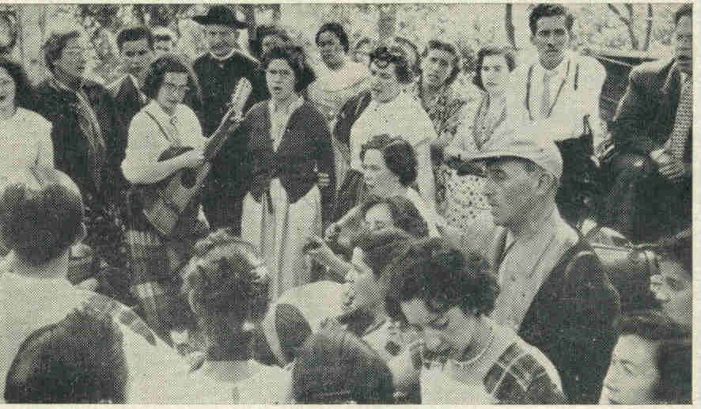
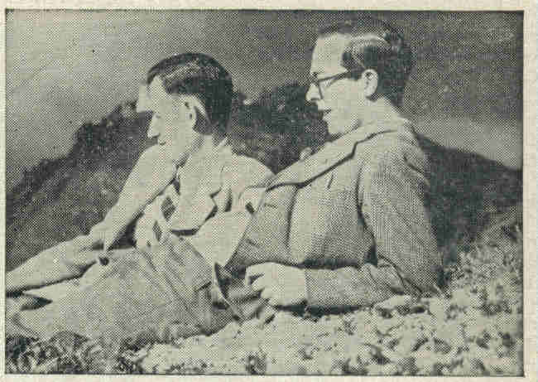
First Stop: Colombia
Alfie and Seamus Grace spent Christmas in Colombia on the topmost peak of the Andes overlooking Bogota.
Notes:
At the time the envoys arrived, Colombia had the Legion in 18 dioceses and had about 250 praesidia.
Protestant missionaries had flocked to South America by the thousands and were undermining the faith of the inhabitants.
The Legion was doing great work to counteract those influences.
The first photo shows a Legion function in Colombia: Comitium secretary, Lilia Sanchez, is playing the guitar. Fr. Werner looks on.
The second photo was taken on Christmas day.

Slide 15
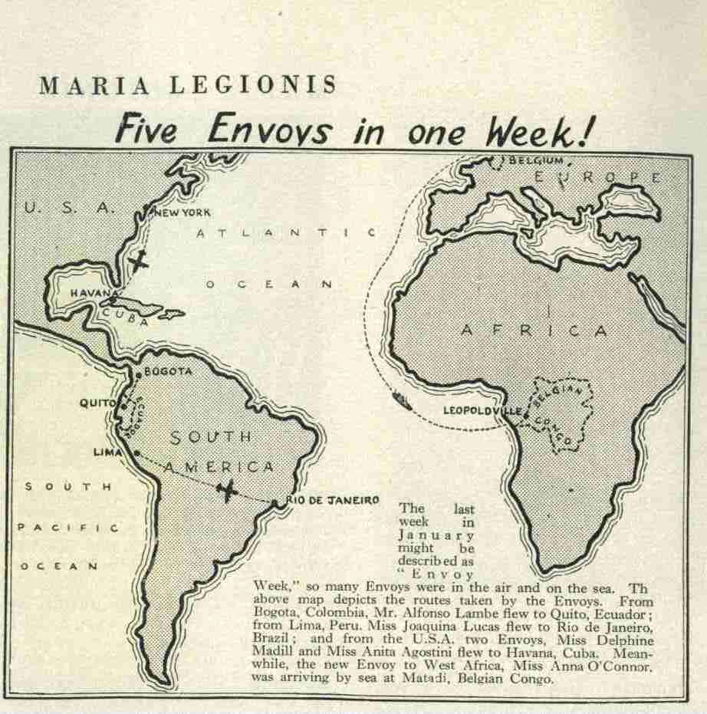
Envoys
Maria Legionis, March 1954
Five Envoys:
Alfie Lambe from Colombia to Ecuador
Joaquina Lucas from Peru to Brazil
Two to Cuba
One to West Africa
Notes:
1954 was a busy time in the Legion:
Alfie flew from Bogota, Colombia to Quito, Ecuador
Joaquina Lucas flew from Lima, Peru to Rio de Janeiro, Brazil
Two envoys flew to Cuba from USA: Delphine Madill and Anita Agostini
Anna O’Connor traveled from Ireland to Matadi, Belgian Congo by sea.

Slide 16
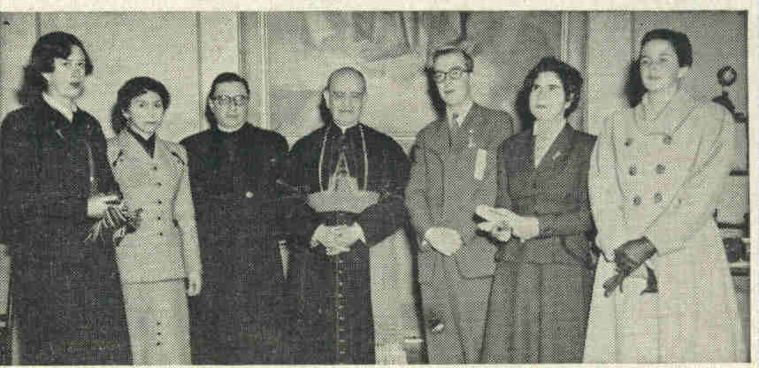
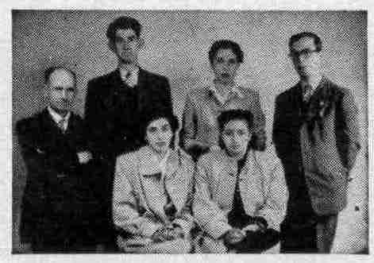
Quito, Ecuador
Cardinal de la Torre gives permission for the introduction of the Legion in his archdiocese
Alfie sends his first extension team to take the field in Ecuador
Notes:
Cardinal de la Torre received the Colombian extension workers. (Next to him is Fr. Barrera, spiritual director of the Quito Curia.)
The second photos shows embers of the Ambato Curia, started by Alfie Lambe.

Slide 17
“The Missing Envoy”
“You must have been thinking that I had disappeared from the face of the earth. . . . The weeks past have been full of work and mad activity. I traveled all Peru by air, by train, by bus, by lorry and on foot . . . ”
Notes:
The Sept. 1955 Maria Legionis notes: “Our Envoy, Mr. A. Lambe, who had been visiting the Curiae in Peru for the past few months was “posted as missing” – no letters having been received from him for several weeks. Then came a thrilling report:

Slide 18
Net Result:
Curiae in Trujillo, Cuzco and Puño in Peru
The first Curia in Bolivia, at La Paz
Some 20 new Praesidia in Lima
The Legion was visited and strengthened in Arequipa and Chimbote
Notes:
The article ends: “Such is the life of an Envoy . . . full of crowded fruitful busy hours!”

Slide 19
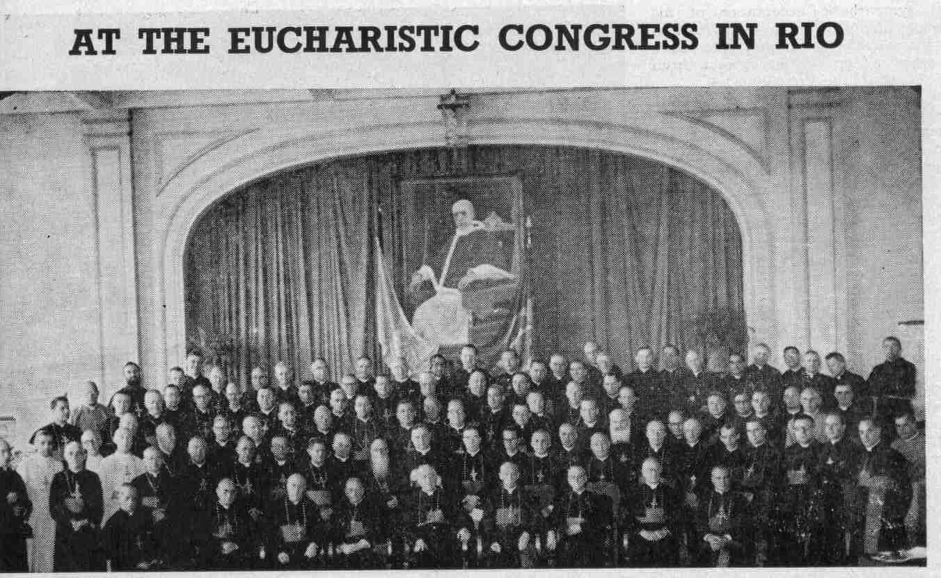
A Red-Letter Day for the Legion
“Cardinals and Bishops have words of praise for the Legion.”
Notes:
In July 1955 the International Eucharistic Congress was held in Rio de Janeiro.
(It is interesting to note that Alfie was born in June 1932, the month that the Eucharistic Congress was held in Dublin, so his life was book-ended by two of these special events.)

Slide 20
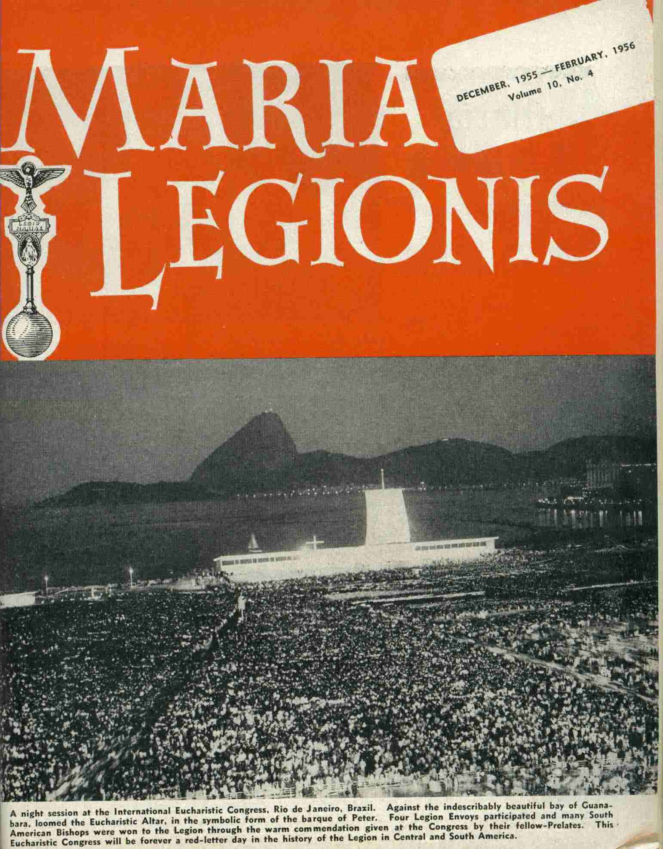
Notes:
The Eucharistic Altar was set up to symbolize the Barque of Peter on the Bay of Guanabara.

Slide 21
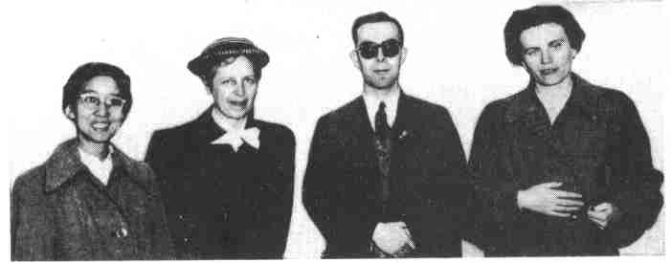
Four Legion Envoys participated
Joaquina Lucas (Brazil)
Maria Diepen (leaving for Dutch Guiana)
Alfie Lambe (going from Ecuador to Argentina)
Mary Clerkin (Brazil)
Notes:
The envoys staffed a stall at the Congress Center where they gave out Legion literature and spoke to the visitors.
Between them, they were fluent in 7 languages, so they could speak to almost everyone who came by.
Alfie met with cardinals, bishops, priests, and lay people and introduced the Legion to many who did not yet have it in their dioceses.
He wrote to Dublin: “I met almost all the Bishops.”

Slide 22
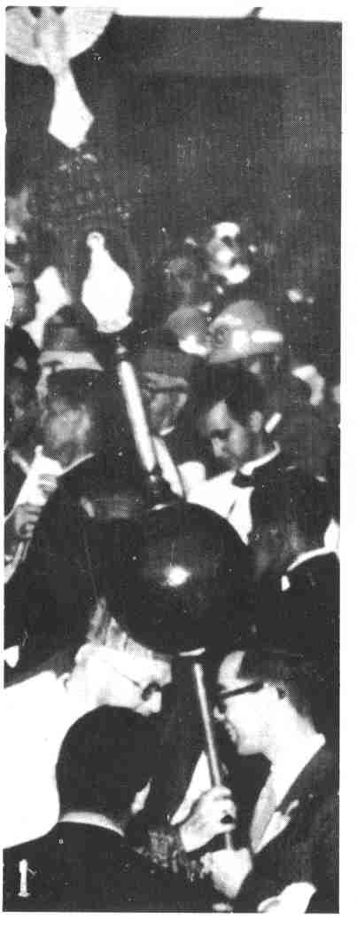
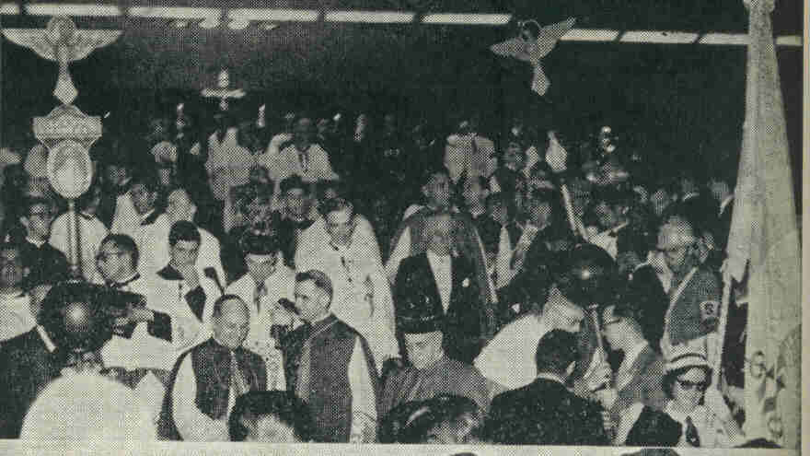
With Cardinal John D’Alton of Ireland:
Notes:
This is after the final Benediction of the Eucharistic Congress: Cardinal D’Alton stops to have a few words with Alfie.
The Legion was held in high esteem at the Congress: During the closing of the Congress, the Holy Father (Pius XII) spoke to the Brazilian Nation. Legion standards were in front of the High Altar alongside the Papal flag and the flag of Brazil.

Slide 23
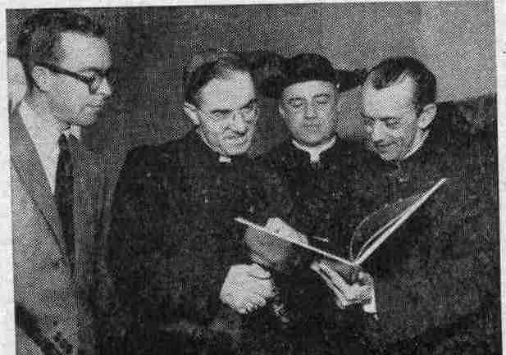
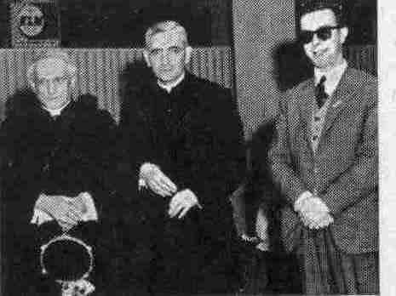
Many Bishops asked Alfie to come to their Dioceses
Notes:
Bishop Samore from the Vatican, Bishop Lombardi – Nuncio in Brazil, Bishop Camara – Archbishop of Rio
Archbishops of Havana, Cuba and Guatemala – both wanted Alfie to come to their dioceses.

Slide 24
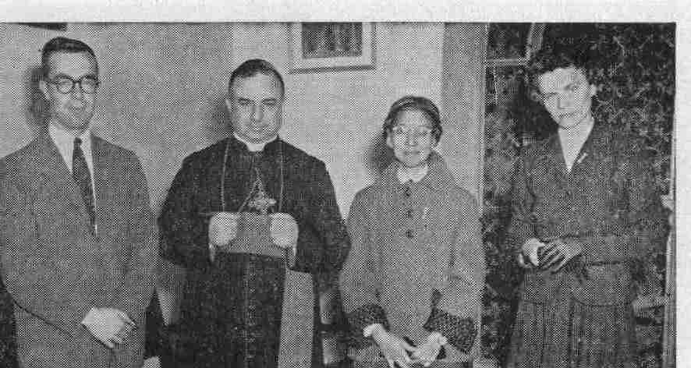
“Bishop Lombardi, the Apostolic Nuncio in Brazil...
...promised full cooperation for the extension of the Legion apostolate and expressed the wish to be kept in touch with the progress of the work.”
Notes:
With Bishop Lombardi, Joaquina Lucas, and Mary Clerkin

Slide 25
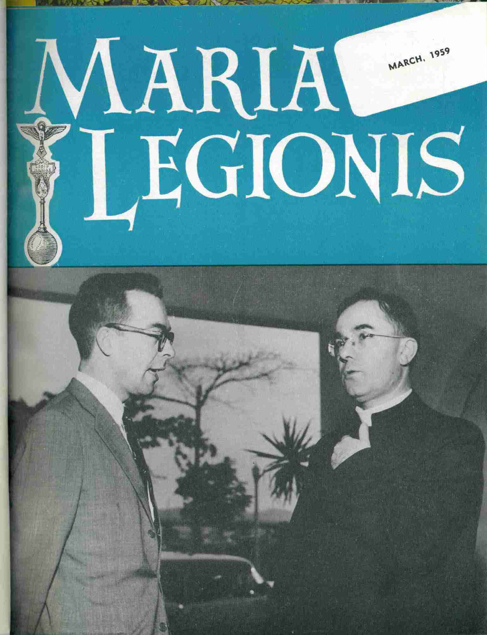
With Bishop Semore, the Secretary of the Congregation of Extraordinary Affairs of the Vatican
Notes:
From Maria Legionis: “His Excellency spoke [with Alfie] of the extension of the Legion in Colombia and Ecuador and insisted that the carrying out by the Legion of hard and solid apostolic work would be its surest way of spreading to all the South American continent.”

Slide 26
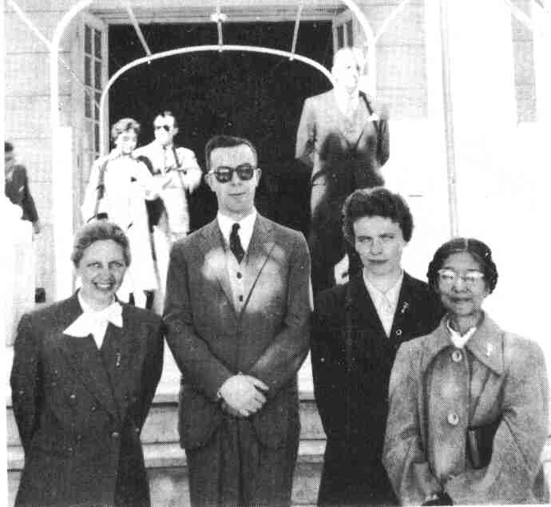
Maria Legionis, December 1955:
“Four Legion envoys participated and many South American bishops were won to the Legion through the warm commendation given at the Congress by their fellow Prelates. This Eucharistic Congress will be forever a red-letter day in the history of the Legion in Central and South America.”
Notes:
Maria Diepen, Alfie Lambe, Mary Clerkin, Joaquina Lucas

Slide 27

Travels throughout South America
Argentina
Uruguay
Paraguay
Back to Argentina
Notes:
After the Eucharistic Congress, Alfie left for Argentina. He also worked in Uruguay and Paraguay, then returned to Argentina.
The next several slides show miscellaneous photos of Alfie’s travels.

Slide 28
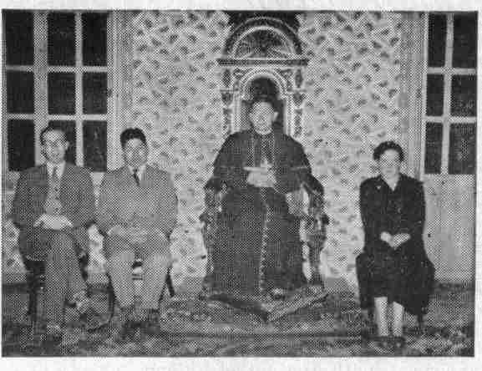
Bishop Proano of Bolivar
“The Legion is the salvation of my diocese.”
Notes:
Bishop Proano was spiritual director of two praesidia and a Curia himself and planned to have curiae in every region of his diocese.

Slide 29
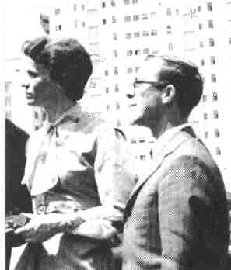
With Mary Clerkin in Rio

Slide 30
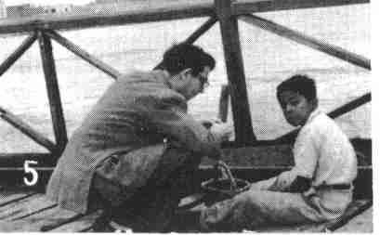
Fishing with a Peruvian Boy

Slide 31
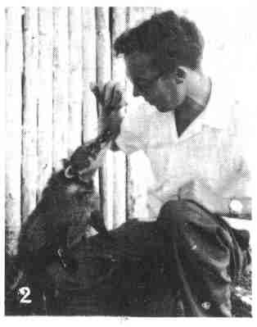
Feeding an Animal in the Jungles of Paraguay
Notes:
Alfie named this animal “Peter”

Slide 32
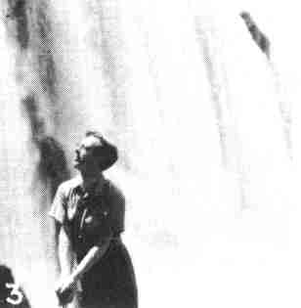
At Iguazu (between Brazil & Argentina)
“Even this is not an impossible obstacle.”
Notes:
From Maria Legionis: “Looking up at the Waterfall of Iguazu, on the borders of Brazil and Argentina, he seems to say: “Even that is not an impossible obstacle.”

Slide 33
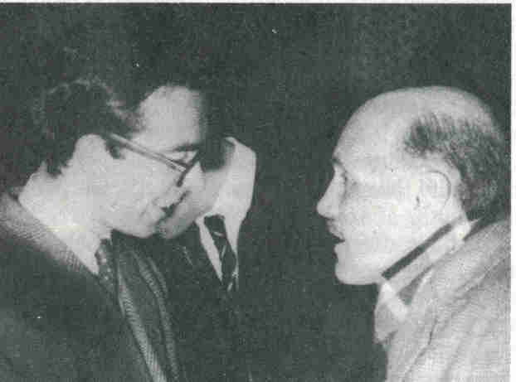
With a Legion Contact
Notes:
This photo was taken in October, 1958 in Buenos Aires. It was sent to Concilium by Sr. Bridget Mooney. She said, “Alfie worked with interest and love for each soul as we can see. The legionary beside him is learning from his example.”

Slide 34
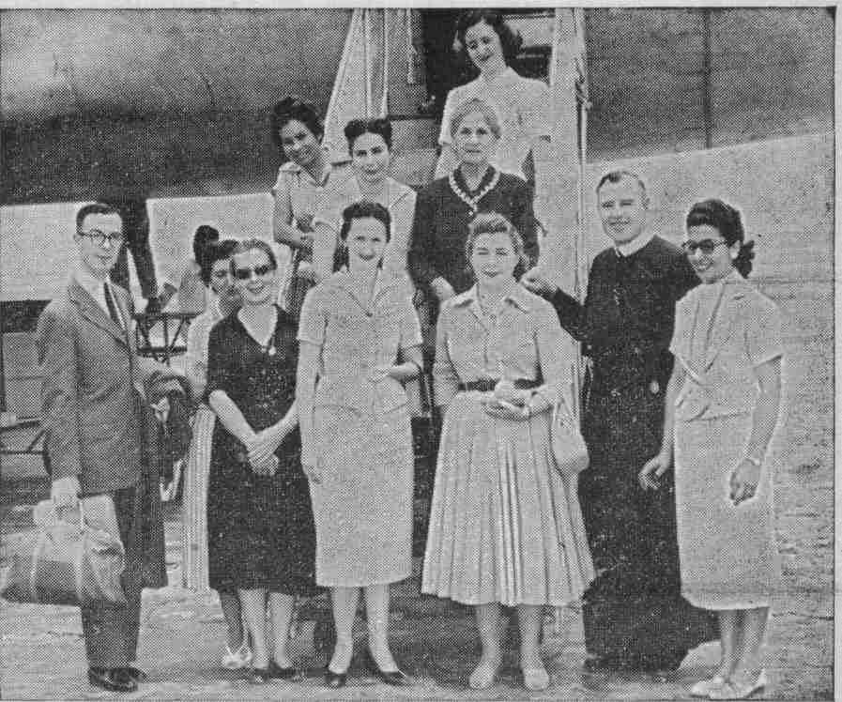
The Arrival of Una Twomey
Notes:
Alfie, Fr. Michael Murphy, and members of the Asuncion Curia meet Envoy Una Twomey who would be working in Paraguay.
The caption in Maria Legionis says: “All are beaming with delight to have two experts in their midst to guide them in work of perfecting the Legion in Asuncion.”

Slide 35
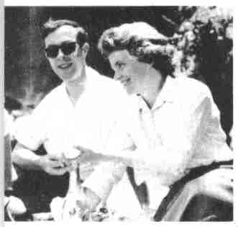
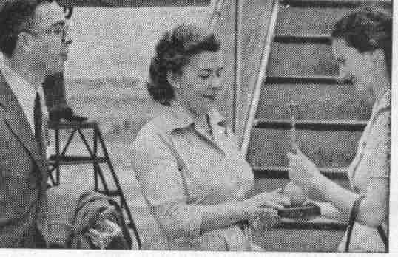
With other Legion Envoys
Notes:
1. Picnic lunch on Christmas Day with Mary Clerkin (and Una Twomey).
2. Una Twomey receiving a vexillum from the Curia president in Asuncion, Paraguay.

Slide 36
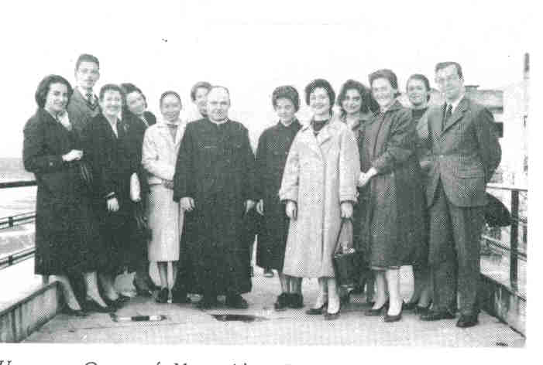
In Uruguay
Notes:
With Fr. Tekeyan and legionaries from Montevideo.

Slide 37
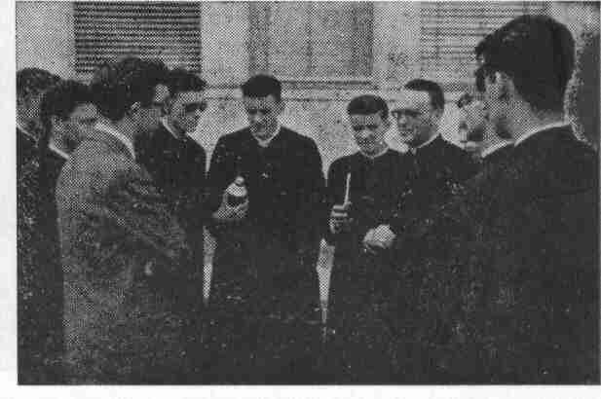
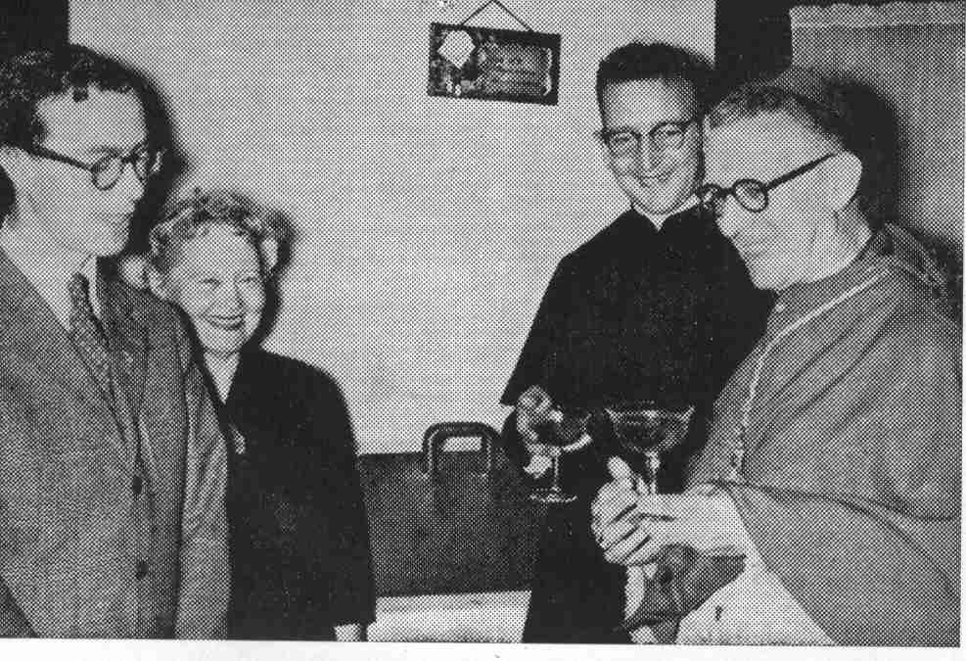
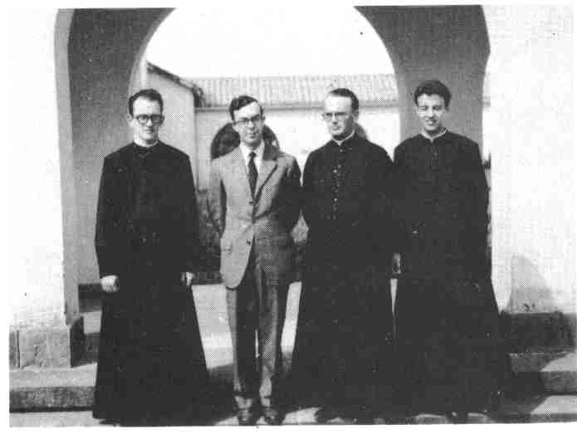
In Argentina
Notes:
1 and 2: With Fr. Di Jacobo, rector of the Seminary of Parana and the presidents of the two seminary praesidia: praesidium of theologians and praesidium of philosophers.
3. On the Feast of the Most Holy Rosary with Bishop Raspanti of Moron and Fr. James McGrath, spiritual director of the Legion in Castelar. Sr. Elisa Fox, next to Alfie, was the praesidium president and a pioneer of the Legion in Argentina.

Slide 38
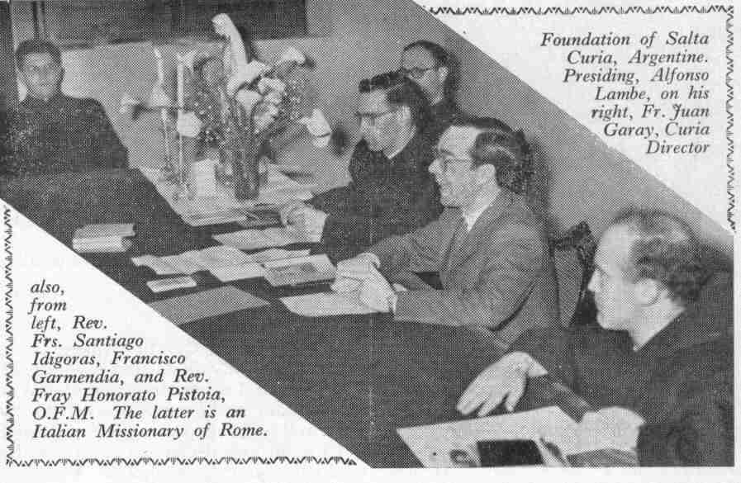
Notes:
Alfie is running the first meeting of the Salta Curia.

Slide 39
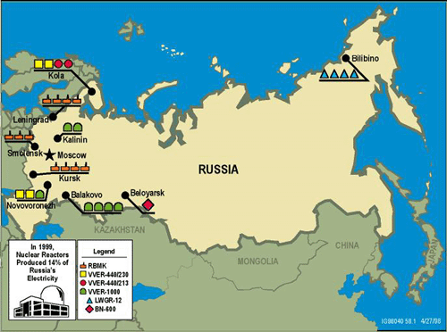
Alfie’s Dream
Alfie studied Russian
Arranged to have the handbook translated into Russian
Established a praesidium among the Orthodox in Buenos Aires
Asked permission to make a tourist visit to Russia
The Legion eventually began making annual PPCs to Russia
Notes:
Besides Alfie’s great interest in South America, he dreamt of being an envoy to Russia when his time in South America was completed. Frank Duff notes that, “None of us would doubt that Alfie’s yearnings and preparations formed a contributory part of that development.”

Slide 40
Illness
In Cordoba, Argentina, Alfie was diagnosed with a stomach ulcer
He was taken to Buenos Aires to a hospital run by Blue Nuns
1/9/59: an operation revealed cancer
He was visited every day by the Irish Ambassador to Argentina
Notes:
The Irish Ambassador was Mr. T. J. Horan

Slide 41
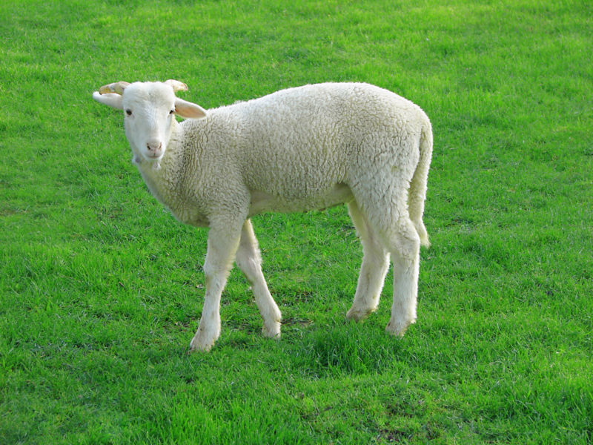
Death
Alfie received the Last Rites administered by Cardinal Copello
The Nuncio gave the Last Blessing
Alfie died on January 21, 1959 at the age of 26
He was buried in the Christian Brothers vault in Buenos Aires
Notes:
In a sense, his wish to be a Christian Brother was granted at death.

Slide 42
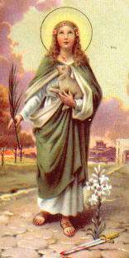
January 21st
Feast of St. Agnes
Alfie was known in South America as
“El Cordero” (the lamb) or “El Corderito” (the lambkin)
Notes:
St. Agnes is always shown with a lamb.
It was the custom every year on this feast for two lambs to be presented to the Holy Father.
Frank Duff wrote, “It has been pointed out that the Legion gave the Eternal Father a lamb on that 21st January, the reference being to the term cordero or corderito (meaning a lamb) by which Alfie was everywhere affectionately known.”

Slide 43
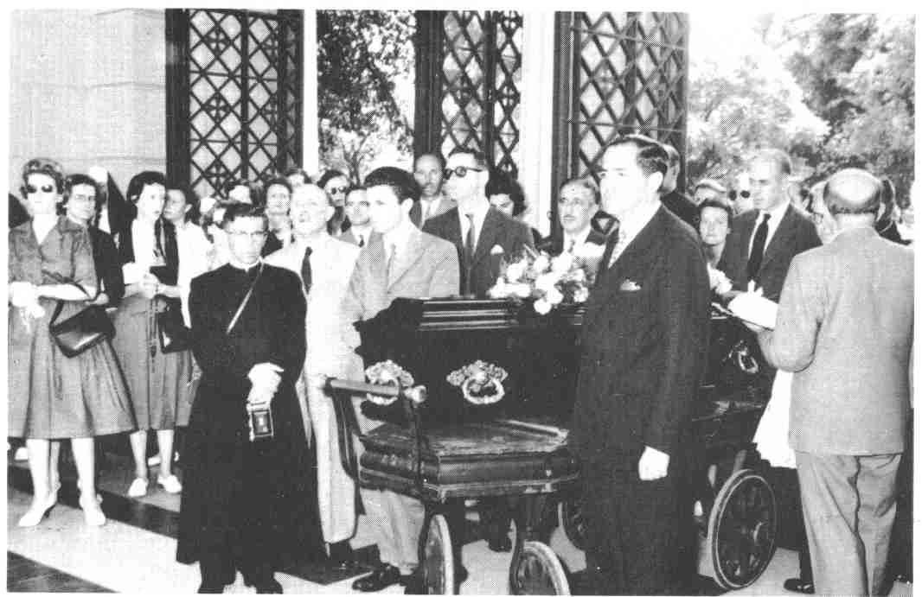
Funeral

Slide 44
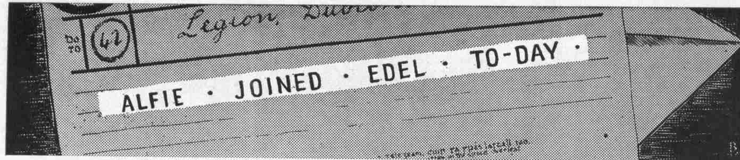
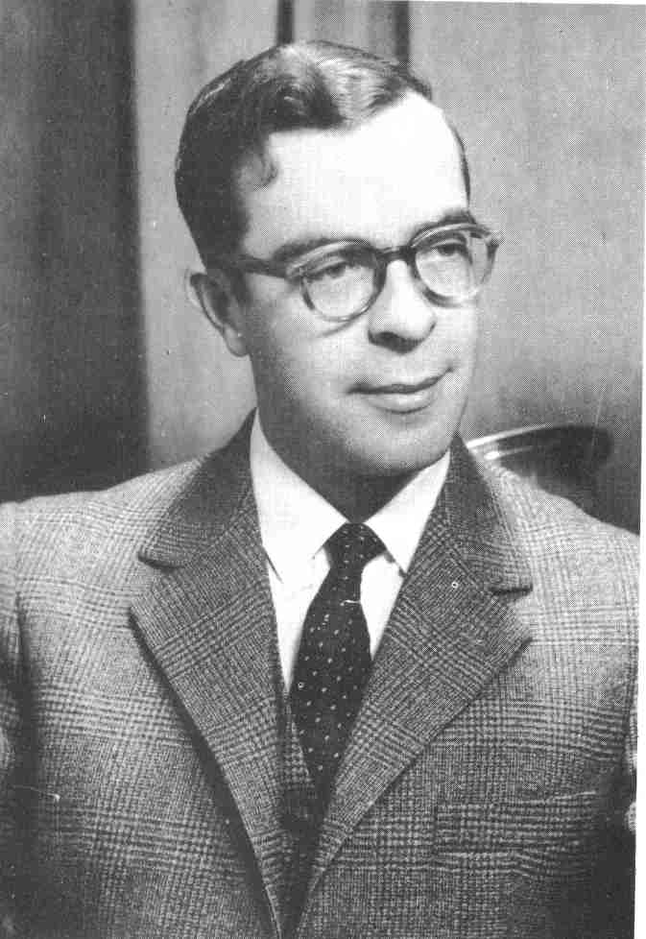
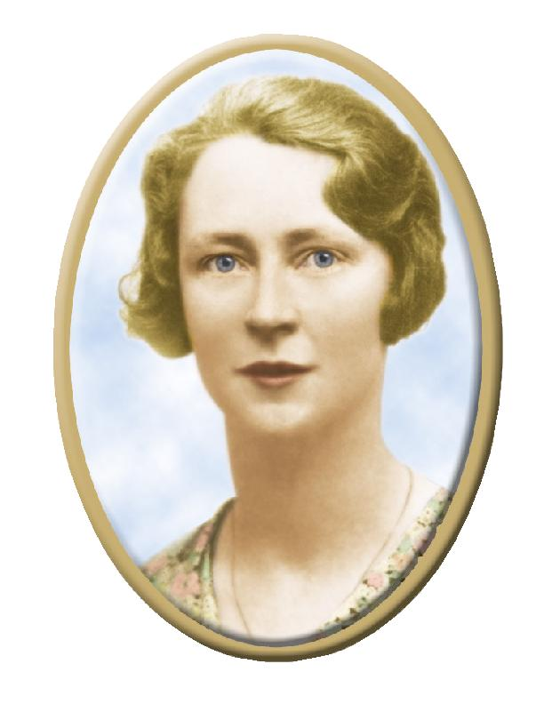
Notes:
Word was sent to Dublin by telegram: “Alfie Joined Edel Today.” This was the title of the lead article in the March, 1959 Maria Legionis.
Frank Duff wrote: “One may institute a parallel between him and Edel. Each was wise and charming and lovable and without kinks. Each represented a frustrated vocation converted into a supreme triumph. In her case it was accomplished in eight years and in his case in six. She is being acclaimed as a model for modern youth. He would fulfill the same role and in a particular way for male youth.”

Slide 45
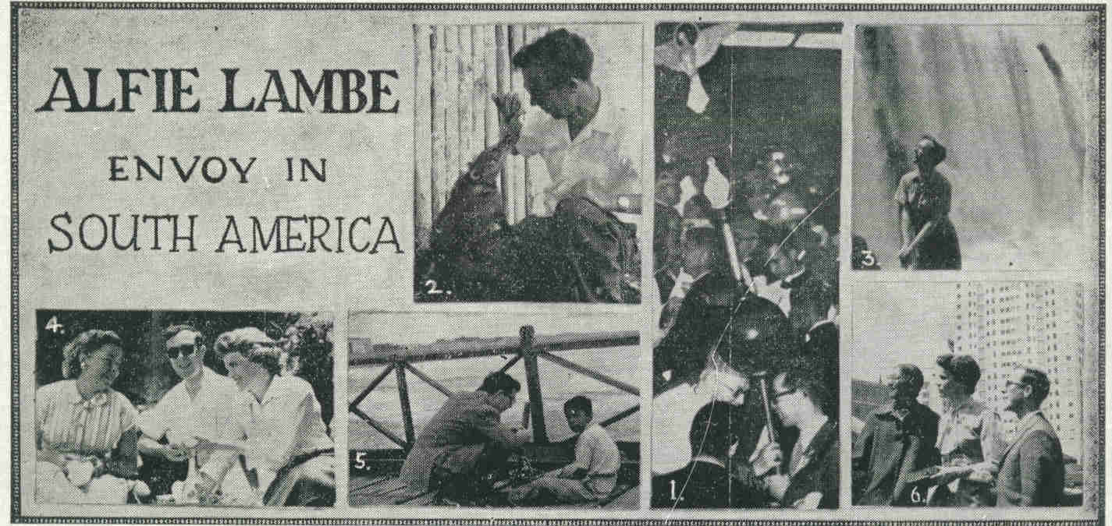
Maria Legionis
March, 1959
Notes:
The cover of the March, 1959 Maria Legionis was devoted to Alfie.

Slide 46
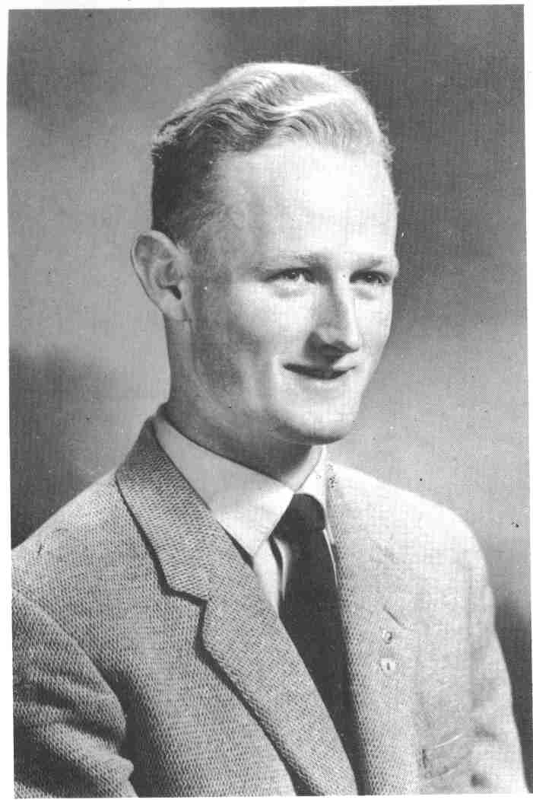
Noel Lynch
Notes:
Noel Lynch had been assigned to assist Alfie Lambe in Argentina. He arrived two days after the funeral and, at the age of 22, took Alfie’s place instead.

Slide 47

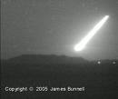
“A Meteor”
“The life of Alphonsus Lambe was like a meteor. It flashes suddenly before us, soaring to giddy heights, but hardly have we admired its splendour, than it is gone. . . .
Notes:
In 1967, “Alfie Lambe, Legion Envoy” was written by Hilde Firtel, Legion Envoy to Germany.

Slide 48

“But whereas a meteor leaves no trace, Alfie’s work is thriving and flourishing in all the countries where he was active. The flame which consumed the Irishman and which he knew how to enkindle in all those who surrounded him, has become a wildfire which has seized an entire continent.”

Slide 49
Cause for Beatification
In February 1980 the Cause for Canonisation was Introduced in a letter to the Holy Father by the Archbishop of Buenos Aires, Cardinal Aramburu.

Slide 50
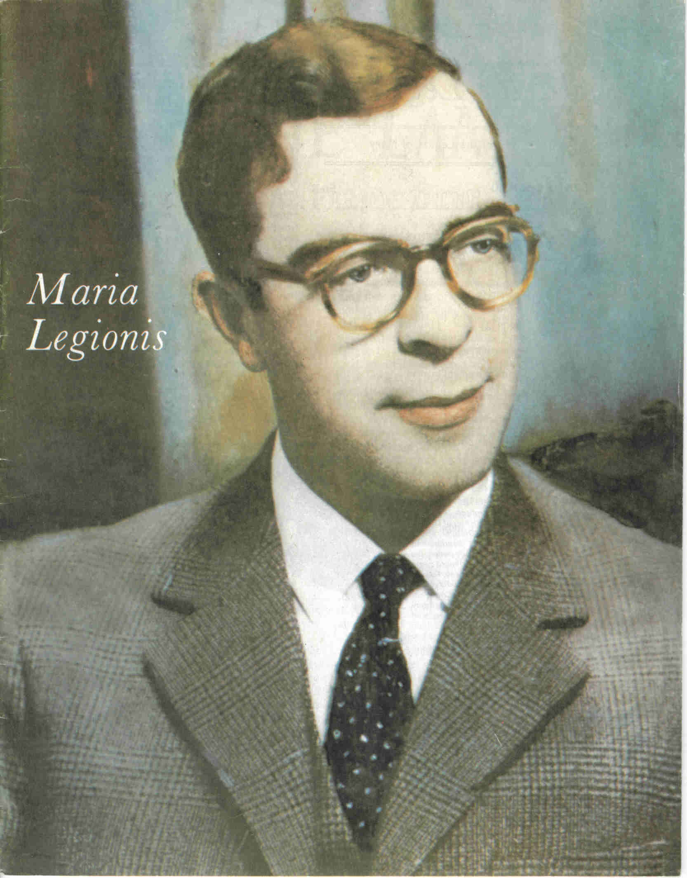

Maria Legionis, 1980
Notes:
In order to make Alfie’s cause better known,, Frank Duff wrote an article on him in 1980. He wrote, “Do I think that Alfie is canonisable? Yes, I do. I could not see any defect in him. That by itself could be a negative state. In him it was supplemented with a faith without limit, and other heroic qualities. He gave all his energies to the pursuit of souls. He had Our Blessed Lady in a perfect perspective.”

Slide 51
Prayer for the Beatification of the Servant of God Alphonsus Lambe
O God, who by your infinite mercy
inflamed the heart of your servant, Alphonsus Lambe
with an ardent love for you and for Mary, our Mother;
a love which revealed itself
in a life of intense labour, prayer and sacrifice
for the salvation of souls;
grant, if it be your will,
that we may obtain, by his intercession,
what we cannot obtain by our own merits.
We ask this through Jesus Christ, Our Lord.
Amen.
Notes:
All legionaries are asked to promote the Cause of Alfie Lambe by reciting this prayer daily and encouraging others to pray for Alfie’s intercession as well. Please join me in praying for his beatification right now.

Slide 52
Please spread devotion to Alfie Lambe and pray to him for your special intentions!

Slide 53
To the tune of “Edelweiss”
Alfie Lambe, Alfie Lambe
Envoy extraordinary
Alfie Lambe, Alfie Lambe
Gave his whole self to Mary
Model of all who would do the same
Perfect legionary
Alfie Lambe, Alfie Lambe
Pray for each legionary

